Slide 1
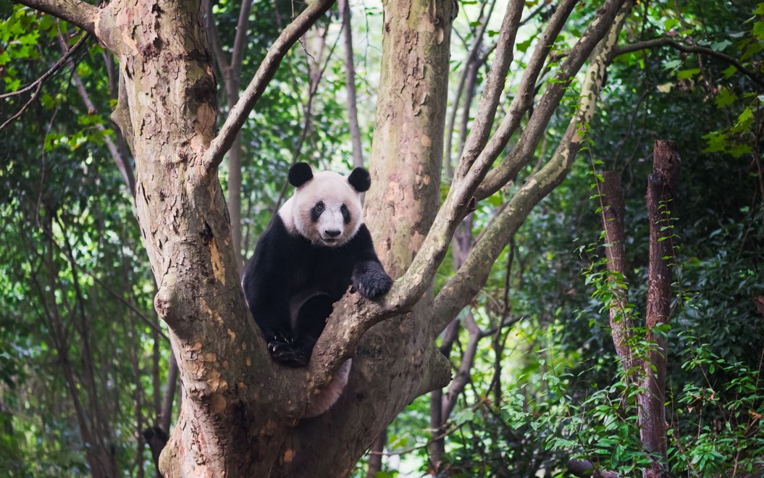


Living things and their habitats
For parents
Thank you for supporting your child’s learning in science.
Before the session:
Please read slide 2 so you know what your child is learning and what you need to get ready.
You may wish to print pages 7 & 8.
During the session:
Share the learning intentions on slide 2.
Support your child with the activities on slides 3 to 6 as needed.
Slide 9 has a glossary of key terms.
Reviewing with your child:
Slides 10-12 gives an idea of what your child may produce.
Making branching keys and
classifying vertebrates
Year 6
Age 10-11

Slide 2
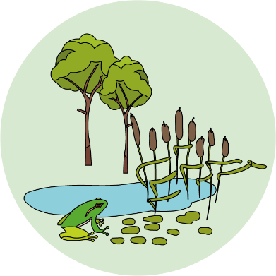
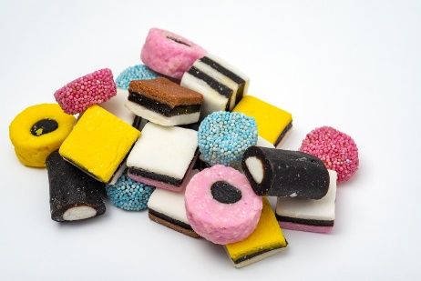

Year 6 Living things and their habitats
Logo for section to sit inside roundel
Making branching keys and classifying vertebrates
Key Learning
Branching keys are useful for classifying things, using descriptions of features or characteristics.
Vertebrates can be divided into five main groups: Fish, Reptiles, Amphibians, Birds and Mammals.
Each vertebrate group has distinctive characteristics.
Investigation (pages 2-4): 10-15 minutes.
You will need:
paper and a pencil.
one packet of liquorice allsorts.
(alternatively, use photos on page 8 or a biscuit variety pack)
Thank you to SAPS for this activity – more details on p.19 of their guide: www.saps.org.uk/attachments/article/1377/SAPS%20book%205%20-%20Grouping%20and%20Classification%20-%202016.pdf
Activity (pages 5-7): 20-30 minutes.
Use lined paper, a ruler and a pencil.
Alternatively, print and cut out labels on page 7.
I can…
Make a branching key to classify a group of objects.
Make a branching key to classify vertebrates (animals with a backbone).
2

Slide 3
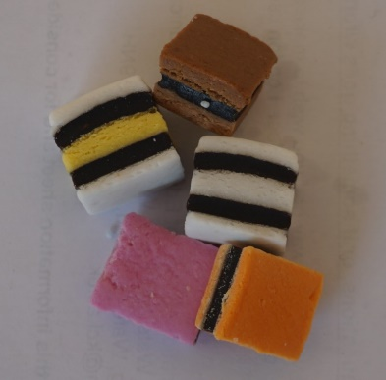
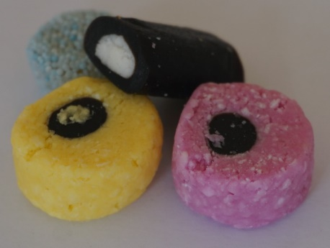

Explore, review, think, talk….
Logo for section to sit inside roundel
Creating questions about liquorice allsorts with yes/no answers
(page 3-4: 10 to 15 minutes)
Investigate…
Spread out about 10 different liquorice allsorts (or cut out / draw images from page 8).
Talk or think about their features:
  Round or square?
  Number of different colours?
  Smooth or rough surface?
Select 8-10 different sweets and try writing down some questions which will give the answer ‘yes’ for some sweets and the answer ‘no’ for the rest:
For example: Is it round? Is it pink? Is it smooth?
Test each question by sorting the sweets into two piles:
For example:
Is it a square shape?
Yes
No
3

Slide 4
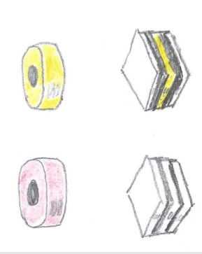
Explore, review, think, talk….
Logo for section to sit inside roundel
Making a branching key with four liquorice allsorts
A branching key can be used to classify a group of items. It uses questions. The answer is ‘yes’ for some items and ‘no’ for the others.
Making a branching key for 4 items
Select two different square shaped sweets and two round shaped sweets.
Make your first question ‘Is it a square shape?’
Think of different questions to sort
  (a) the square shapes.
  (b) the round shapes.
Now write down the questions like this on a sheet of paper (your questions and sweets may be different):
Is it a square shape?
Put your sweets on the paper to complete the key!
yes
no
Is it only black and white?
Is it pink?
yes
no
yes
no
4

Slide 5
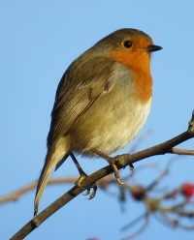
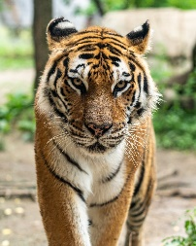
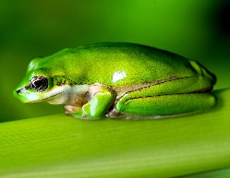
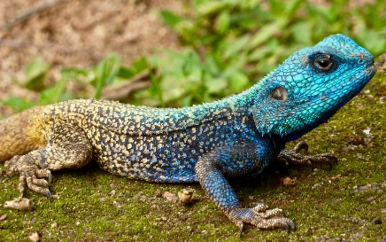
Making a branching key
Logo for section to sit inside roundel
Make a branching key for vertebrates using questions about their characteristics
(page 5-7: 20 to 30 minutes)
In your last lesson you learnt about the features or characteristics of animals with a backbone, vertebrates.
For example:
Birds and mammals are warm blooded; fish, reptiles and amphibians are cold blooded.
Fish and reptiles have scales; birds, mammals and amphibians do not.
Vertebrates can be classified using a branching key.
Think about some questions you could ask when making a key for vertebrates.
Here is an example of a key for a frog, a lizard, a robin and a tiger.
Is it warm blooded?
yes
no
Does it lay eggs?
Does it have a smooth moist skin?
yes
no
yes
no
5

Slide 6
Create a branching key for a mammal, a fish, a reptile and a bird.
Possible questions:
Is it warm blooded?
Is it cold blooded?
Does it lay eggs?
Does it provide milk?
Does it have fur or hair?
Does it have scales?
Does it have feathers?
Does it have a smooth moist skin?
Does it have gills?
I can make a branching key to classify vertebrates.
You can draw your key with a pencil and ruler or ‘cut and stick’ using the labels on page 7 and some plain paper.
You may like to try making a key for all five vertebrate groups!
Possible starting questions:
Is it cold blooded?
Does it have scales?
yes
no
yes
no
6

Slide 7
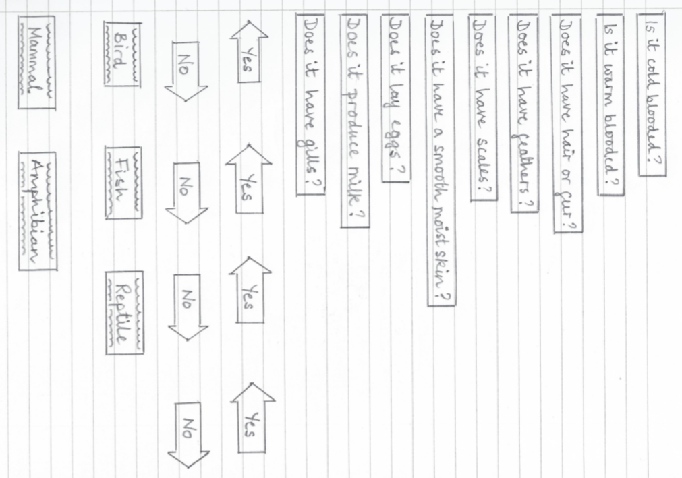
7

Slide 8
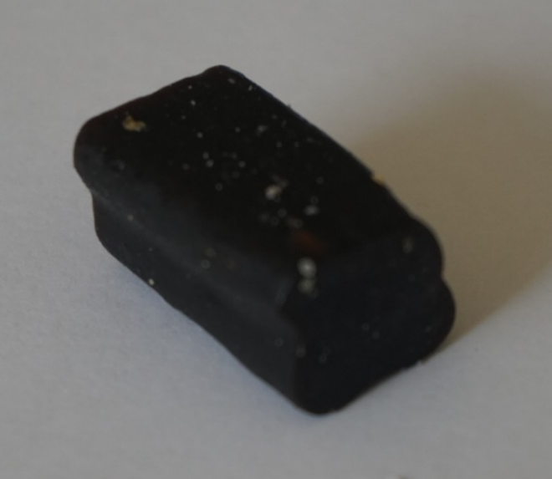
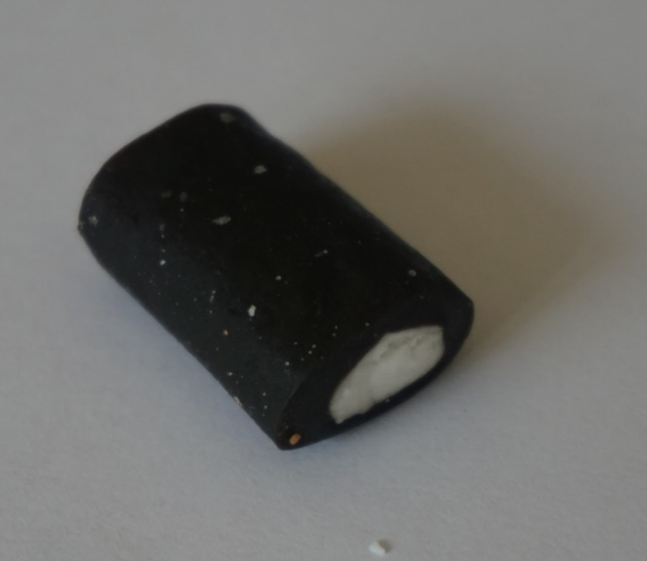
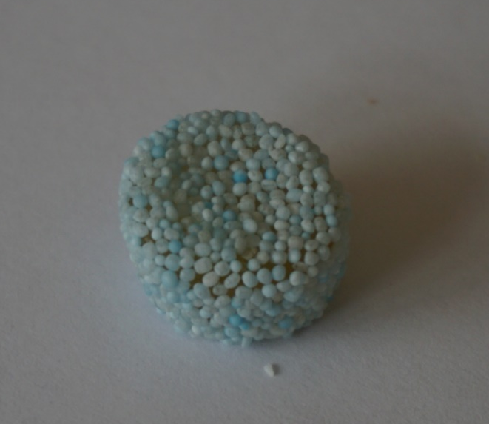
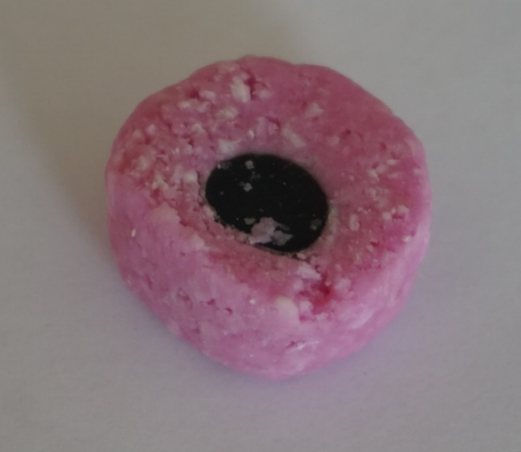
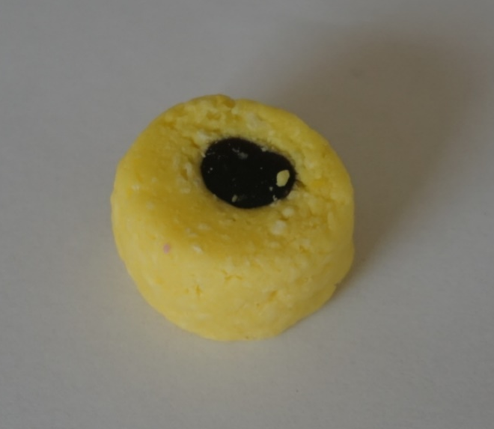
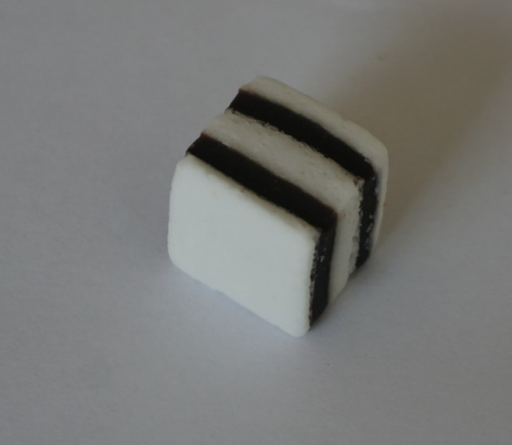
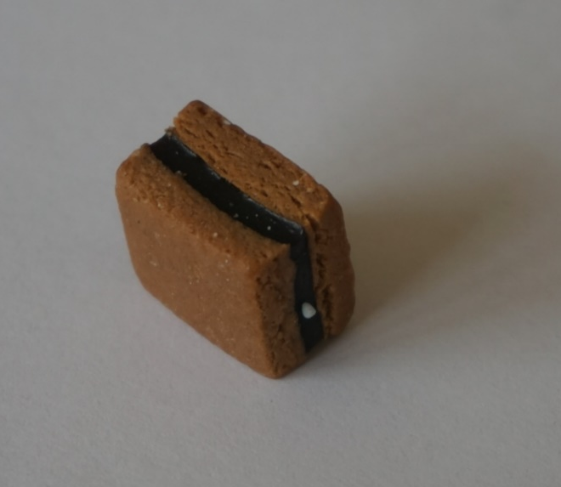
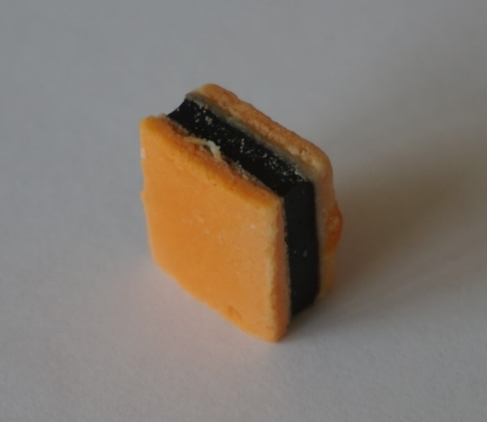
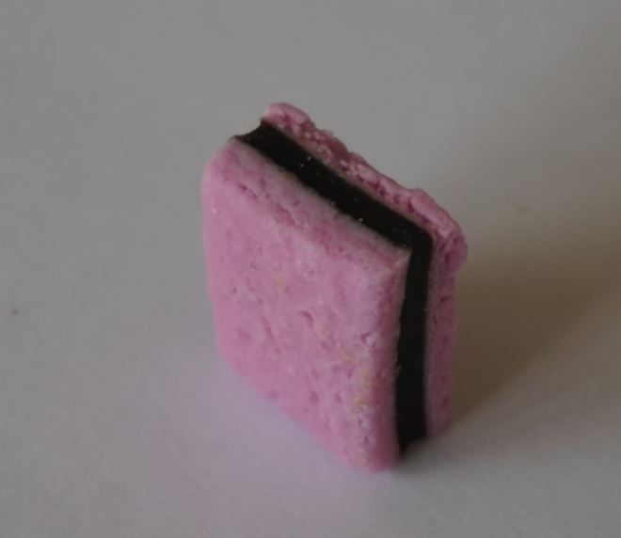
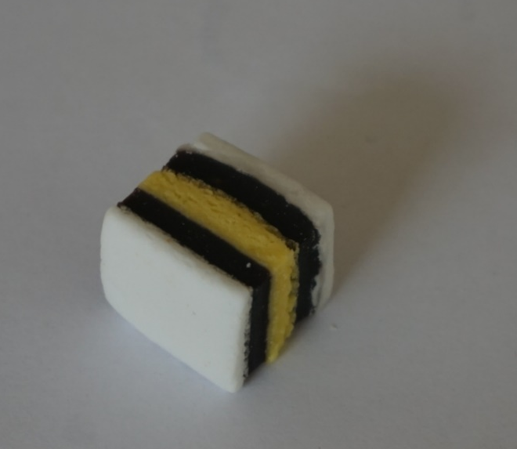
Pictures of some liquorice allsorts to print and cut out - or to draw yourself!
You can also download and print a sheet from STEM learning (no. 15 in Downloads list: pdf of Liquorice allsorts images):https://www.stem.org.uk/resources/elibrary/resource/34255/grouping-and-classification
Alternatively, try making your key using a mixture of biscuits from a variety pack.

Slide 9
Glossary of terms
Characteristic: Characteristics are features of living things which help scientists classify them.
Classification: Classification is the method scientists use to group living things.
Branching key: A branching key can be used to identify different animals. The key asks questions based on features of the animals, where the answer is ‘yes’ or ‘no’.
For example, the question ‘Is it cold-blooded?’ has the answer ‘yes’ for reptiles, fish and amphibians and ‘no’ for mammals and birds.
Vertebrate: A vertebrate is an animal with a backbone.
9

Slide 10
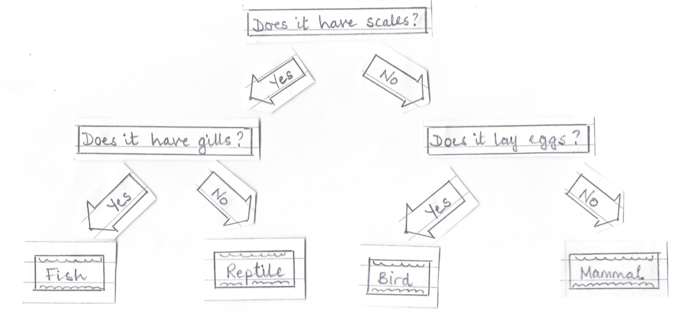
Possible learning outcome for reviewing your work.
I can make a branching key to classify four vertebrates.
You may like to add pictures of animals to the key.
Your key may look different. There are many valid outcomes
(other examples on pages 11 and 12).
You can use other questions which relate to different features of vertebrates.
For example, birds have wings (although some do not fly).
10

Slide 11
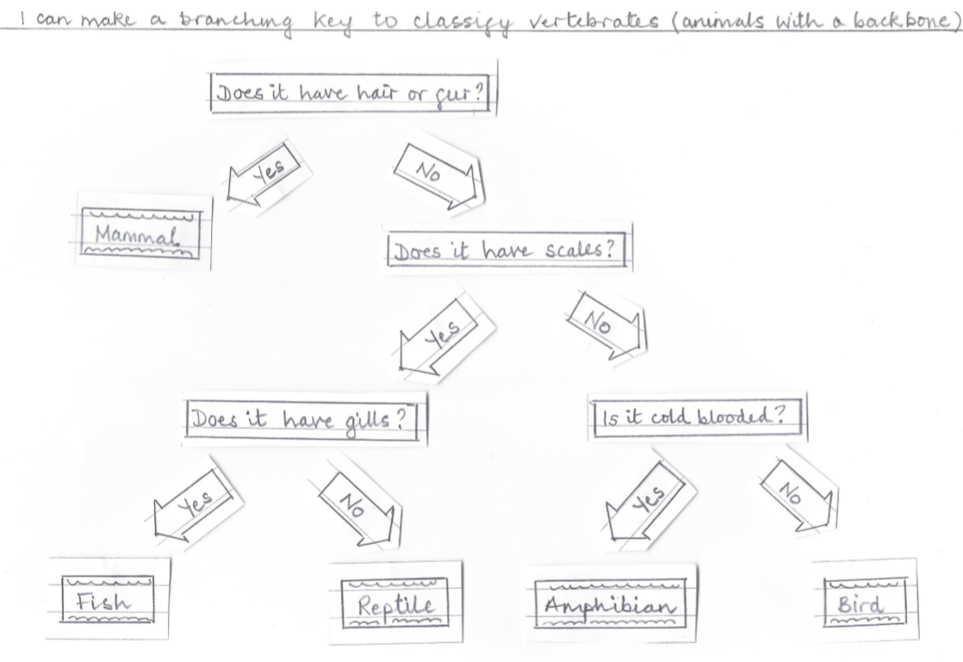
Possible learning outcome for reviewing your work.
This is one example. There are many possible ways of arranging the questions to make a valid key.
You can cut out or make labels and move them around to make alternative keys.
You may like to record your work by taking photographs.
11

Slide 12
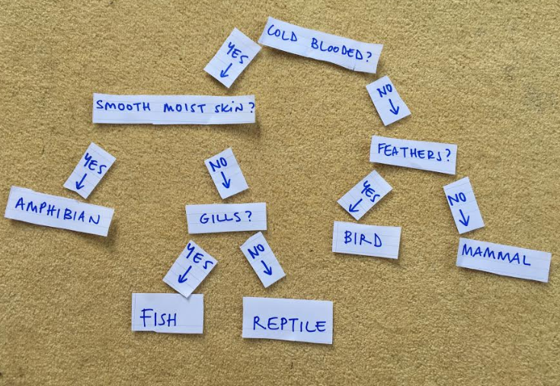
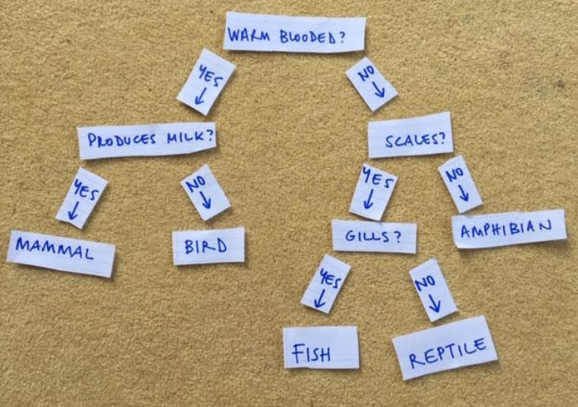
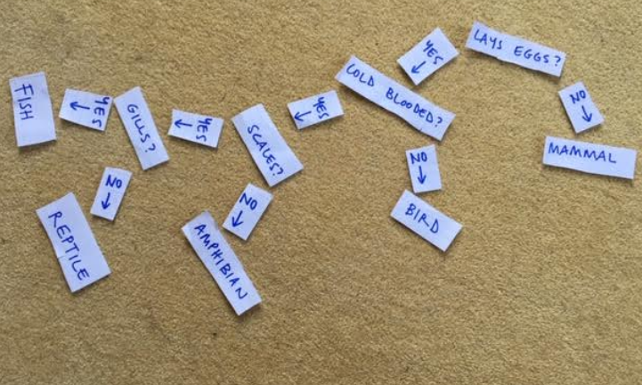
This pupil made her own labels and moved them round to make different keys.
12

