Slide 1
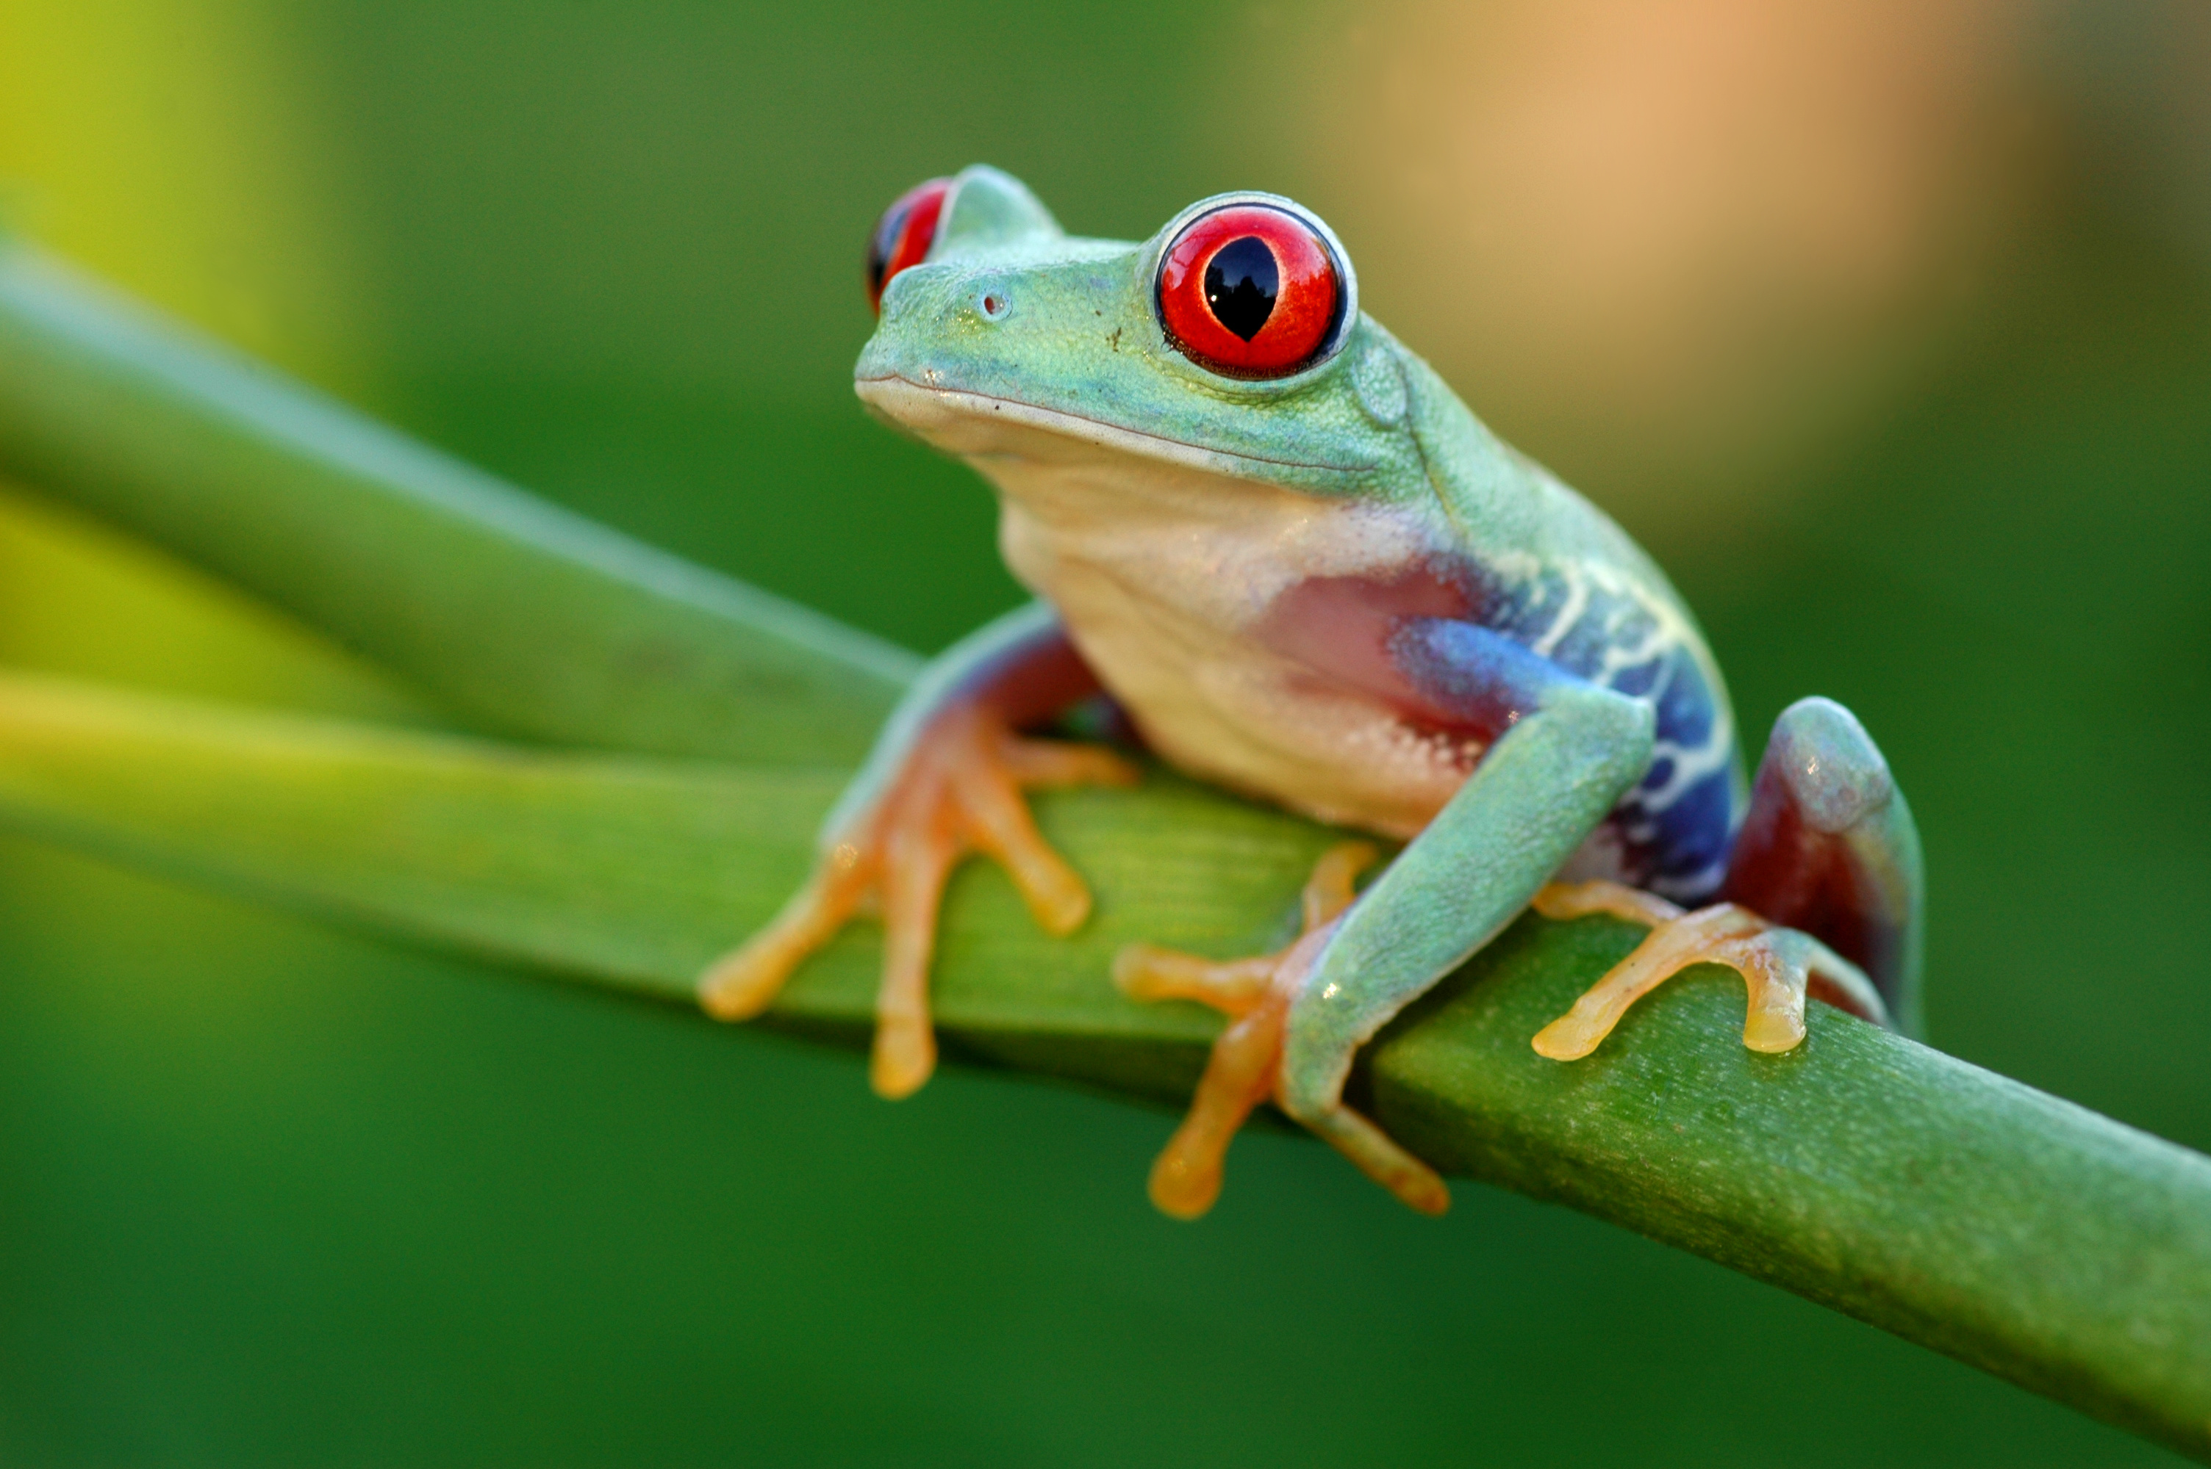



Living things and their habitats
For parents
Thank you for supporting your child’s learning in science.
Before the session:
Please read slide 2 so you know what your child is learning and what you need to get ready.
As an alternative to lined paper, slide 5 may be printed for your child to record on.
During the session:
Share the learning intentions on slide 2.
Support your child with the main activities on slides 3,4 & 5, as needed.
Slide 6 is a further, optional activity.
Slide 7 has a glossary of key terms.
Reviewing with your child:
Slide 8 gives an idea of what your child may produce.
Animals with a backbone:
Classifying vertebrates
Year 6
Age 10-11

Slide 2
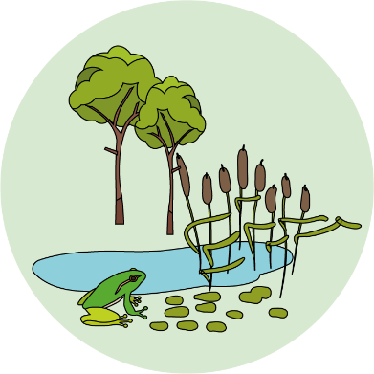


Living things and their habitats
Logo for section to sit inside roundel
Animals with a backbone: Vertebrates
Key Learning
Animals can be divided into two main groups: vertebrates (animals with backbones) and invertebrates (animals without backbones).
Vertebrates can be divided into five main groups: Fish, Reptiles, Amphibians, Birds and Mammals.
Each vertebrate group has distinctive characteristics.
Activities (pages 3-5): 30 - 40 mins
Use lined paper, a ruler and a pencil.
Alternatively, print page 5 as a worksheet.
Find out more… (page 6): 20 - 30 mins
Find out more about a vertebrate of your choice; you may choose to research a family pet.
I can…
Describe the characteristics of Fish, Reptiles, Amphibians, Birds and Mammals.
2

Slide 3
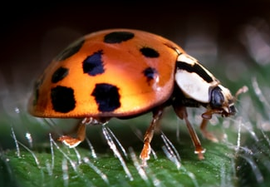
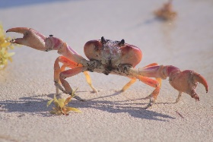
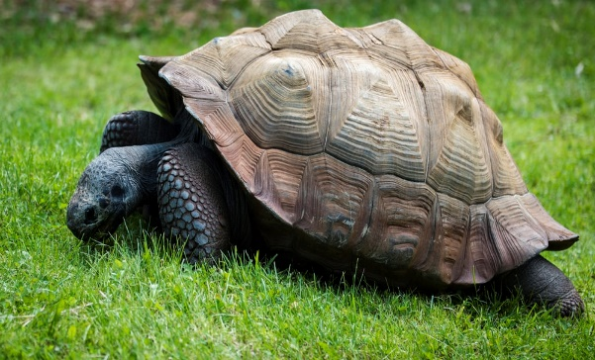

Explore, review, think, talk….
Logo for section to sit inside roundel
What do you already know about animals with and without backbones?
(10 minutes)
Look at these pictures of a ladybird, a crab and a tortoise.
Which one do you think is the odd one out?
Think about the animal characteristics to help you.
You may have chosen body colour, body shape or number of legs to describe the odd one out.
You can also classify animals as vertebrates – with a backbone, or invertebrates – without a backbone.
Watch BBC bitesize to find out whether ladybirds, crabs or tortoises have a backbone. https://www.bbc.co.uk/bitesize/topics/zn22pv4/articles/z8mbqhv
https://www.bbc.co.uk/bitesize/topics/zn22pv4/articles/zp6g7p3
3

Slide 4

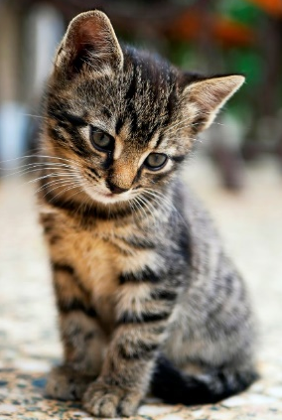
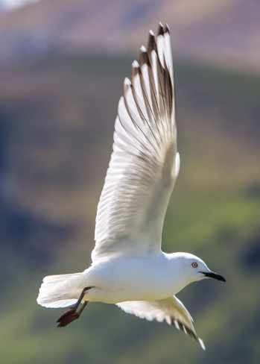
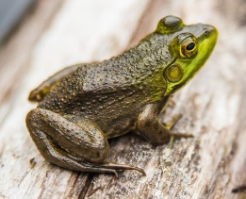
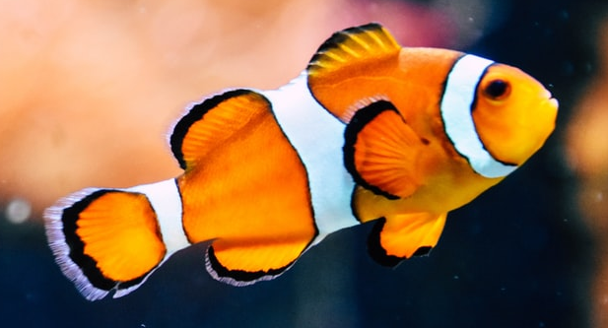
Watch, read, listen…
Logo for section to sit inside roundel
Vertebrates are animals with a backbone
(Page 4-5: 20-30 minutes)
Watch this 7 minute clip about vertebrates. Try to jot down some of the features which help to classify each group.
https://www.bbc.co.uk/teach/class-clips-video/science-ks2--ks3-classification-of-organisms/zh7g92p
Vertebrates can be divided into five main groups: Fish, Reptiles, Amphibians, Birds and Mammals.
Certain characteristics help us to classify vertebrates, such as:
  Warm blooded or cold blooded
  Lay eggs or give birth to live young
  Have fur, hair, feathers, scales or smooth moist skins
For example, birds are warm blooded, lay eggs with hard shells and have feathers.
4

Slide 5
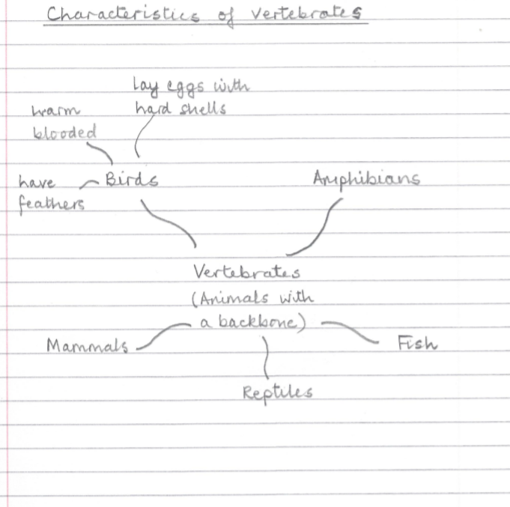
Create a mind map of the five vertebrate groups, adding labels to describe the main features of each group:
Warm blooded
Cold blooded
Lay eggs
Lay soft jelly-like eggs
Give birth to live young
Provide milk
Have fur or hair
Have scales
Have feathers
Have smooth moist skin
Breathe using gills
I can describe some of the characteristics of mammals, fish, reptiles, birds and amphibians.
5

Slide 6
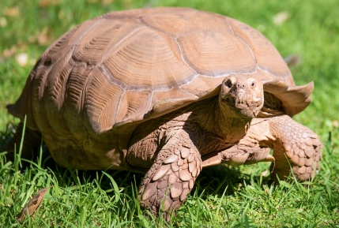
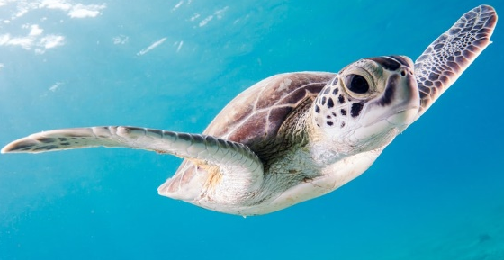
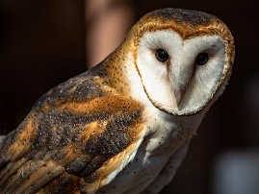
Find out more…about a vertebrate of your choice
Logo for section to sit inside roundel
You may like to choose a family pet
(20 – 30 minutes)
Find out more about a vertebrate of your choice:
Which vertebrate group does it belong to?
Describe its characteristics.
Is it a domestic animal/pet or a wild animal?
Can you find out its two-part Latin name?
What other interesting facts have you found out?
https://www.activewild.com
https://www.dkfindout.com/uk/animals-and-nature
You may like to create a poster.
Suggestions:
Tortoises and Turtles are both reptiles but they live in different habitats.
https://www.dkfindout.com/uk/animals-and-nature/reptiles/tortoises-and-turtles/
Barn Owls are protected in the UK.
https://www.barnowltrust.org.uk/owl-facts-for-kids/
6

Slide 7
Glossary of terms
Characteristic: Characteristics are features of living things which help scientists classify them.
Classification: Classification is the method scientists use to group living things.
Invertebrate: An invertebrate is an animal without a backbone.
Vertebrate: A vertebrate is an animal with a backbone.
7

Slide 8
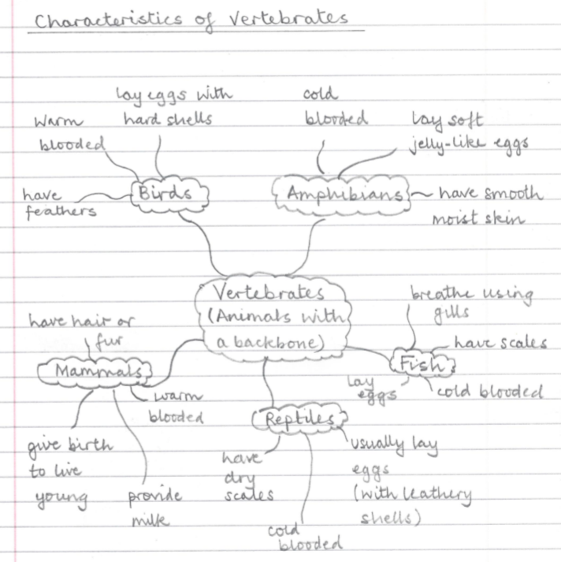
Possible learning outcome for reviewing your work.
I can describe some of the characteristics of mammals, fish, reptiles, birds and amphibians.
Fish have scales and fins. They are cold blooded and lay eggs. They live in water and breathe using gills.
Amphibians include frogs, toads and newts. They have a smooth moist skin and are cold blooded. They lay soft jelly-like eggs and can live on land and in the water.
Amphibians include frogs, toads and newts. They have a smooth moist skin and are cold blooded. They lay soft jelly-like eggs and can live on land and in the water.
Reptiles have dry, scaly skin and are cold blooded. They usually lay leathery eggs.
Mammals have fur or hair and are warm blooded. They give birth to live young and provide milk. Some live in water but need to breathe air, like whales and dolphins.
Birds have feathers and are warm blooded. They lay eggs with hard shells. Birds have wings, but some do not fly.
8

