Slide 1
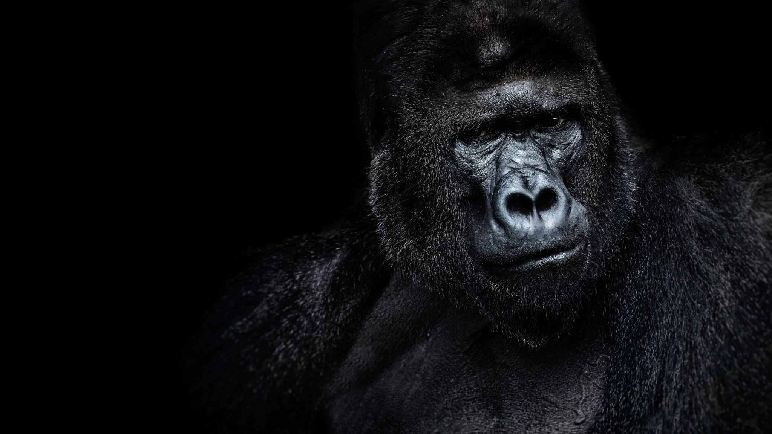



For parents
Thank you for supporting your child’s learning in science.
Before the session:
Please read slide 2 so you know what your child is learning and what you need to get ready.
As an alternative to lined paper, slide 5 may be printed for your child to record on.
During the session:
Share the learning intentions on slide 2.
Support your child with the main activities on slides 3, 4 & 5, as needed.
Slide 6 is a further, optional activity.
Slide 7 has a glossary of key terms.
Reviewing with your child:
Slide 8 gives an idea of what your child may produce.
Living things and their habitats
Classification of living things and
the work of Carl Linnaeus
Year 6
Age 10-11

Slide 2
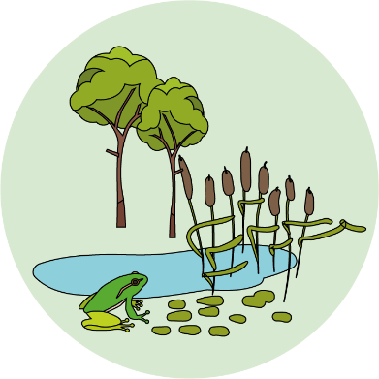


Living things and their habitats
Logo for section to sit inside roundel
Classification of living things and the work of Carl Linnaeus
Key Learning
Living things can be grouped according to characteristics.
The two main groups are animals and plants.
Other living things include fungi and micro-organisms (such as mushrooms, yeast and bacteria).
Carl Linnaeus devised a formal classification system for all living things, which is still used today.
Note to Year 6: Work your way through the slides.
Activities (pages 2-5): should take about 30 - 40 mins
Use lined paper, a ruler and a pencil.
Alternatively, you could print page 5 as a worksheet.
Find out more… (page 6): 20 – 30 mins
Discussion and research.
By the end of the lesson:
I can…
Group examples of animals, plants and fungi/ micro-organisms.
2

Slide 3
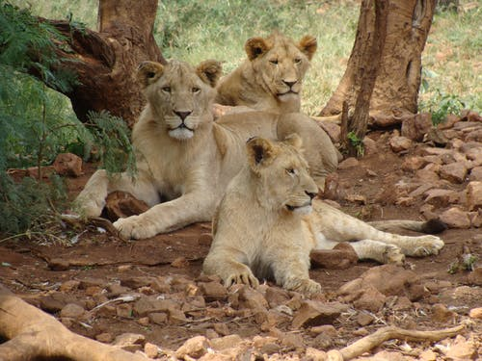
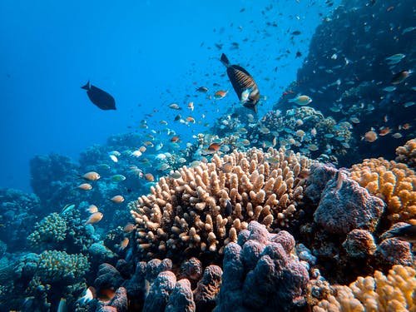
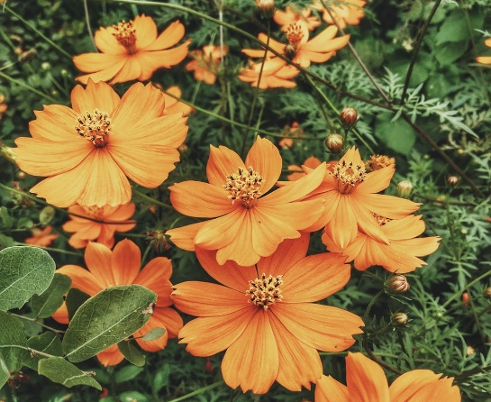
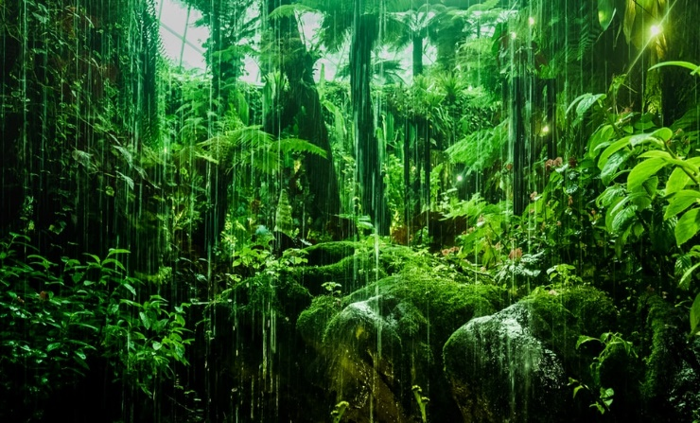
Explore, review, think, talk….
Logo for section to sit inside roundel
What do you already know about grouping or classifying living things?
(5-10 minutes)
Talk or think about five different animals you already know.
What makes an animal an animal?
An animal is a living thing which can obtain and digest food.
Most animals are able to move around to find their food.
Plants come in many shapes and sizes.
What makes plants different from animals?
Watch this short BBC clip about plants
https://www.bbc.co.uk/bitesize/clips/z2k4d2p
Plants make their own food in their leaves using air, sunlight and water.
3

Slide 4
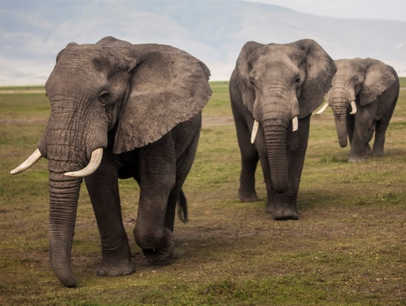
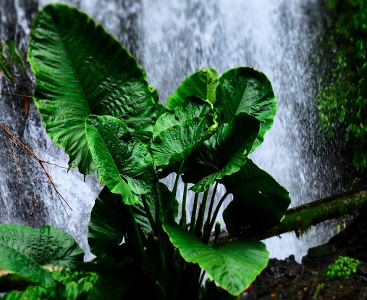
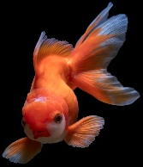
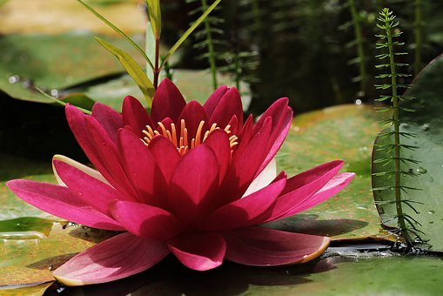
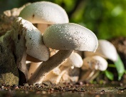
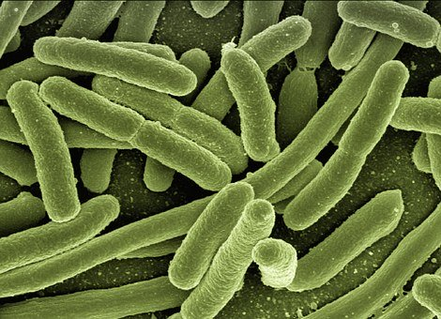
Watch, read, listen…
Logo for section to sit inside roundel
Living things can be grouped into animals, plants, fungi and micro-organisms
(5-10 minutes)
Watch this clip about Carl Linnaeus.
He was an eighteenth century scientist interested in organising plants and animals into groups. He wasn’t successful first time!
https://www.tigtagworld.co.uk/film/carl-linnaeus-PRM00688/
How did Linnaeus simplify the names of plants and animals?
Linnaeus realised living things can be grouped according to characteristics.
He gave each living thing a two-part Latin name.
The two main groups of living things are animals and plants.
Other living things include fungi and micro-organisms, such as mushrooms, yeast and bacteria.
4

Slide 5
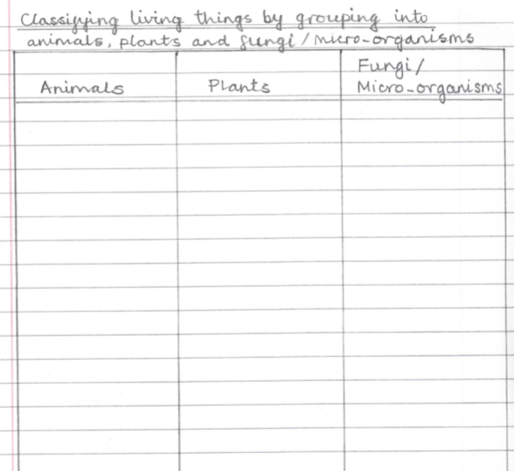

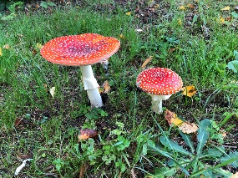
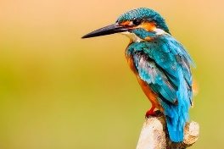
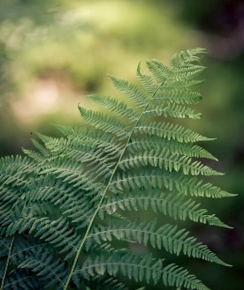
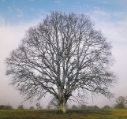

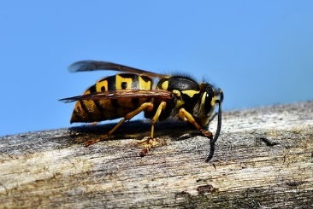
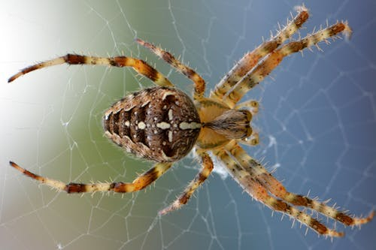
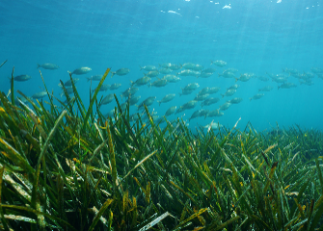
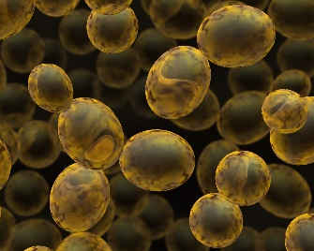
Classify these living things by grouping into Animals, Plants and Fungi / Micro-organisms
goldfish, bacteria, mushroom, toadstool, kingfisher, fern, oak tree, moss, wasp, spider, seagrass, yeast
Add more examples of your own.
I can group examples of animals, plants and fungi / micro-organisms
5

Slide 6
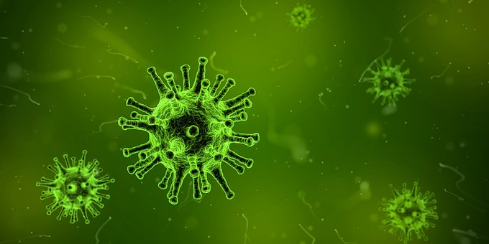
Find out more…about micro-organisms and fungi
Logo for section to sit inside roundel
Optional activity
(20 – 30 minutes)
BBC bitesize on micro-organisms:
https://www.bbc.co.uk/bitesize/topics/zfxxsbk/articles/zsgtrwx
Viruses are similar to bacteria, but are not classified as ‘living things’ because they need a host organism to survive.
Bacteria can be helpful or harmful.
Viruses are usually harmful and can cause diseases, like Coronavirus Covid-19.
Fungi are different to plants, even though many are found in soil.
Find out more about how fungi grow and reproduce.
https://www.kew.org/sites/default/files/2020-02/What-are-fungi-infographic-KS2.pdf
BBC clips on fungi: https://www.youtube.com/watch?v=vZ5Me4N_XXE
https://www.youtube.com/watch?v=puDkLFcCZyI
https://www.youtube.com/watch?v=33-3UCTRZWM
You may like to make a short fact file.
6

Slide 7
Glossary of terms
Animal: An animal is a living thing which can obtain and digest food. Examples include fish, birds, insects, spiders and humans.
Characteristic: Characteristics are features of living things which help scientists classify them.
Classification: Classification is the method scientists use to group living things.
Fungus: A fungus (plural fungi) is a living thing which breaks down dead matter around it, and uses it as food. Examples include mushrooms and toadstools.
Micro-organism: Micro-organisms are small living things, including bacteria and yeast.
Plant: A plant is a living thing which can make its own food. Examples include trees, ferns, mosses and flowering plants.
Virus: A virus is sometimes called a micro-organism but it is not classified as a ‘living thing’ because it needs a host organism to survive.
7

Slide 8
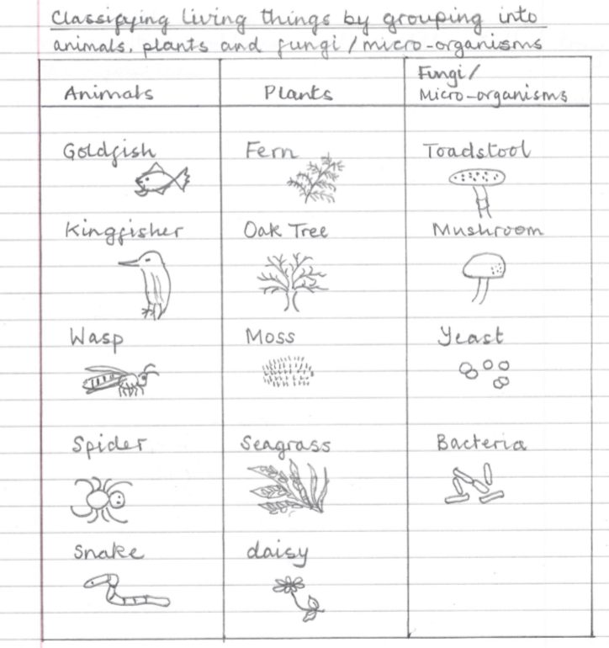
Possible learning outcome for reviewing your work.
I can group examples of animals, plants and fungi / micro –organisms.
Plants include trees, mosses, ferns, grasses and many flowering plants.
Plants in the sea include seagrass and some types of seaweed.
Microorganisms can be ‘good’ or ‘bad’. Many bacteria live in our gut. Bacteria can also cause diseases.
Animals include minibeasts such as insects, spiders and worms. They also include birds, fish, reptiles, mammals and amphibians.
Fungi are different from plants. They include mushrooms and toadstools.
Yeast is a fungus but often classified as a micro-organism.
8

