Slide 1

What does success mean to you?

Slide 2

Jot down your thoughts, memories, questions...

Slide 3


Slide 4
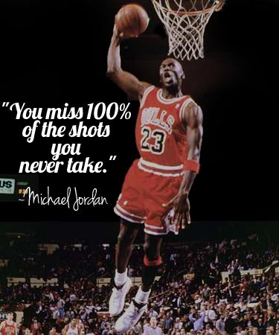
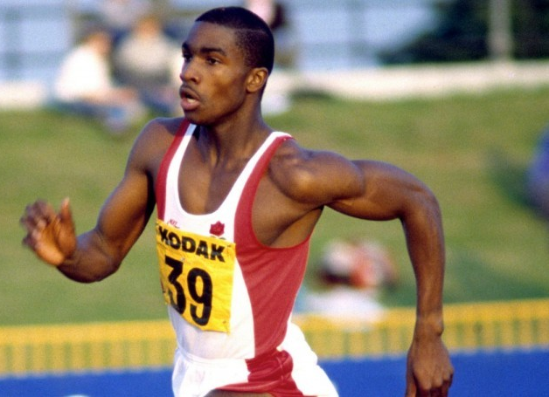
https://www.youtube.com/watch?v=GuXZFQKKF7A
https://www.youtube.com/watch?v=kZlXWp6vFdE

Slide 5


Who do you believe to be successful? Why?
Is it someone close to you or could you research an inspirational figure.
Share your thoughts with the class.

