Slide 1
WALT: Spell words with the suffix -sion

Slide 2
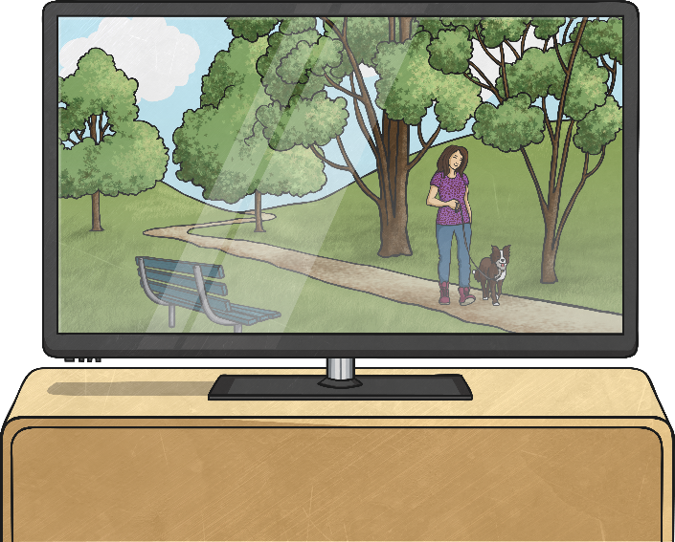
If you were to spell these two words, what would they have
in common?
televi
sion
divi
sion
They both end in the letter string ‘sion’ that sounds like /zhun/ or /shun/.

Slide 3
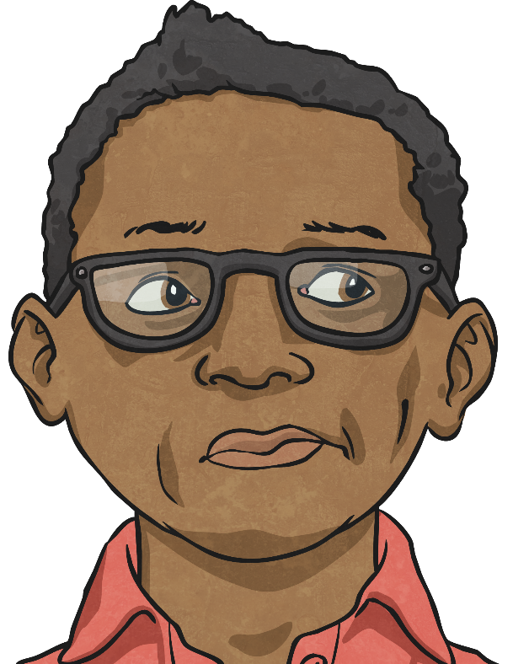
How many words can you think of that end in ‘sion’?
On a piece of paper, write down as many ‘sion’ words as you can think of in the next three minutes.
So, what ‘sion’
words did you
think of?
START

Slide 4


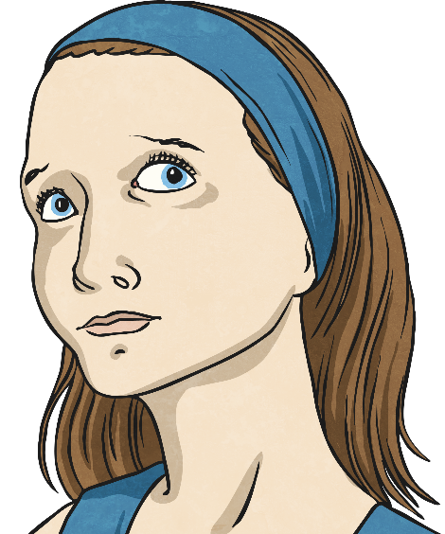
Did you think of any of these ‘sion’ words?
division
invasion
confusion
decision
television
collision
revision
erosion
inclusion
explosion
Do you notice anything about all of these words with the ‘sion’ pattern?

Slide 5
All of the words that end in ‘sion’ have a root word that ends in either de or se. For example…
divide
invade
decide
collide
erode
division
invasion
decision
collision
erosion
include
explode
confuse
televise
revise
inclusion
explosion
confusion
television
revision

Slide 6
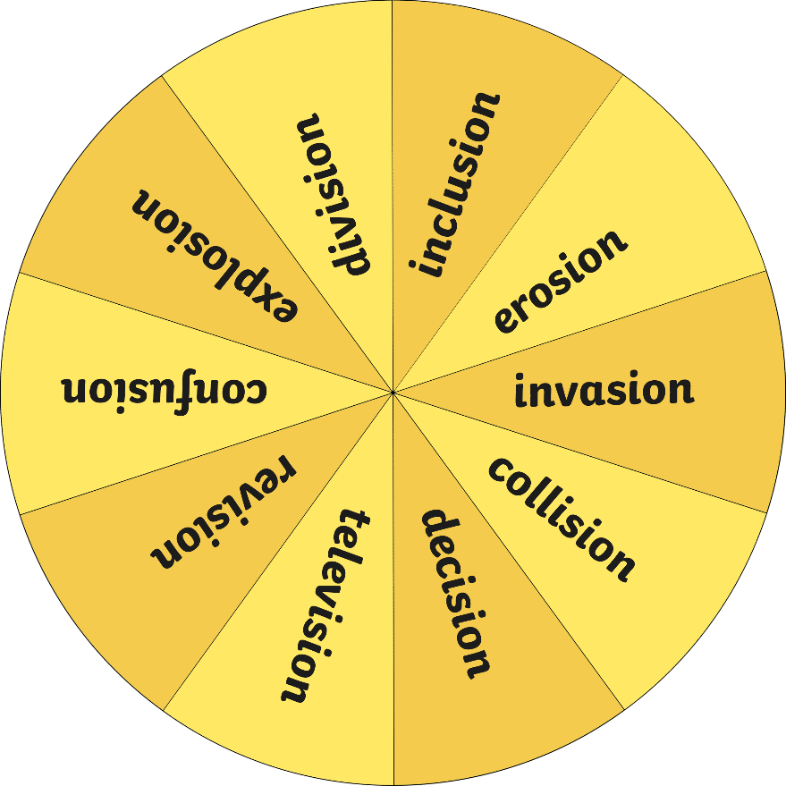
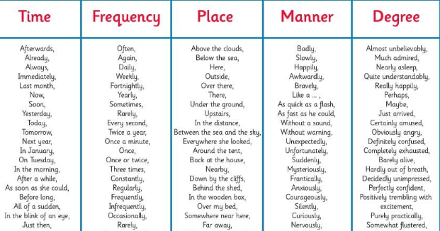
Let’s spin the spinner!
Write an exciting sentence that contains the ‘sion’ word that the spinner lands on…
Does your sentence include an ambitious adjective?
An enormous explosion roared from the monstrous mountain.
Could you add a fronted adverbial to improve it?
Remember, your sentences must use the correct punctuation!!!
Spin
Next Page

