Slide 1
Mountains
Mountains are formed by slow but gigantic movements of the earths crust.
The crust is made up of 6 huge slabs called plates which fit together like a jigsaw puzzle.
Sometimes the crust smashes together, buckles or breaks into huge blocks.
Sometimes magna or erosion force mountains to form.

Slide 2
Mountains
There are 5 different types of mountains
Fold mountains
Fault-block mountains
Dome mountains
Volcanic Mountains
Plateau Mountains

Slide 3
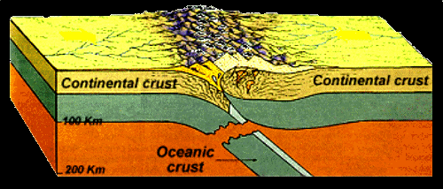
Fold mountains
When two tectonic plates push towards each other

Slide 4
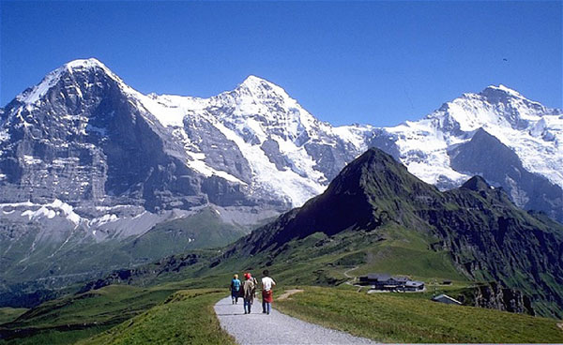
Alps in Europe

Slide 5
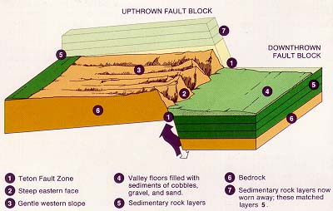
Fault block mountain
Cracks in earth’s crust force materials or blocks of rock sometimes up and sometimes down

Slide 6
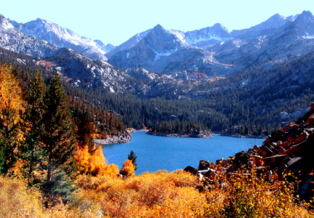
Sierra Nevada in North America

Slide 7
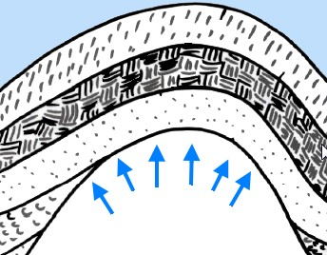
Dome mountains
Great amounts of melted rock (magna) pushes its way under the earth’s crust, but doesn’t crack it.

Slide 8
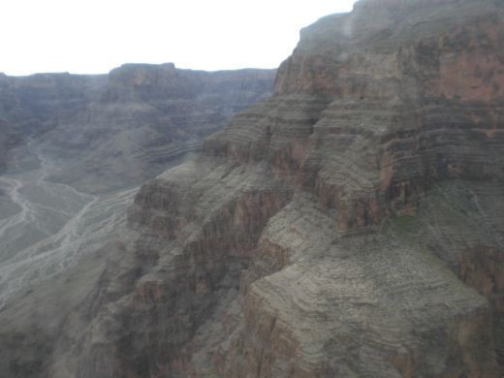
California USA

Slide 9
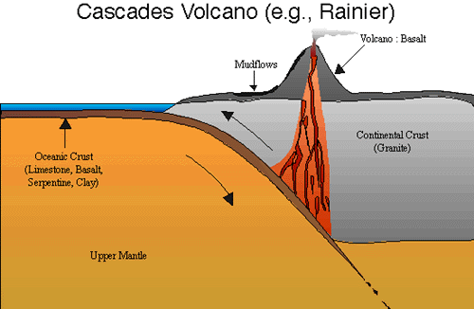
Volcanic mountains
molten rock erupts through the surface of the planet

Slide 10
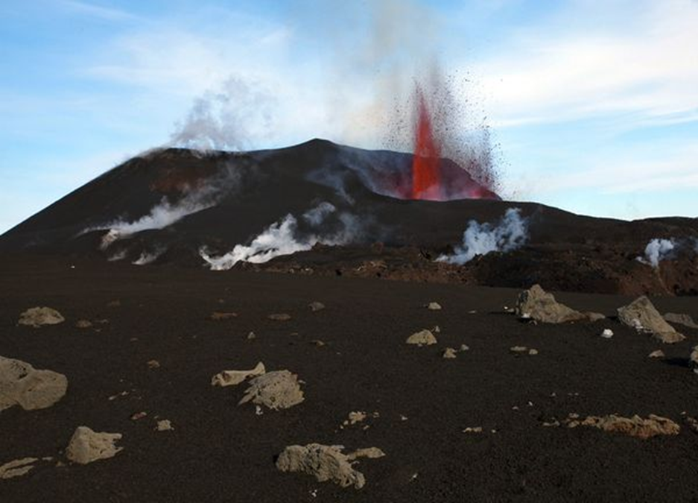
Iceland

Slide 11
Plateau mountains
Caused by erosion of the surrounding areas; for example, by rivers

Slide 12
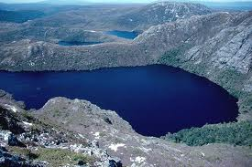
Tasmanian mountains

Slide 13
You will now create these mountains……….

