Slide 1

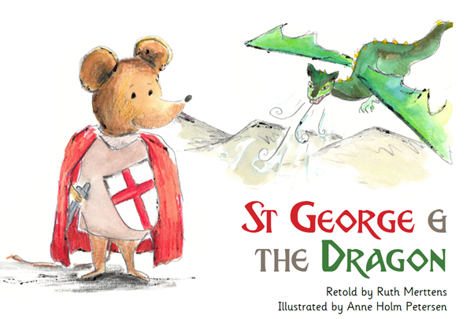
Good Morning!
This week we will be reading a book called ‘St. George and The Dragon. Have a go at the different activities each day in these slides. Don’t forget to submit them when you are done :)

Slide 2
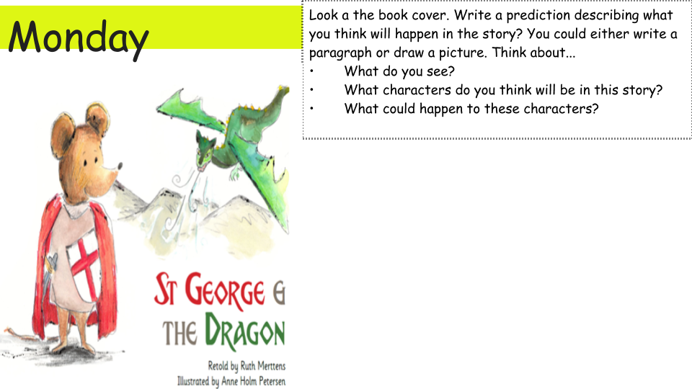
I predict...type answer here

Slide 3
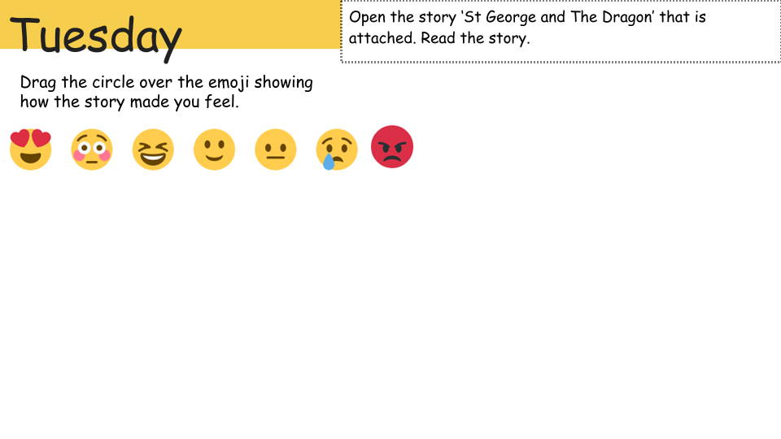
I would recommend this book because...type answer here
I liked...type answer here
I disliked...type answer here

Slide 4
Wednesday
Short summary… type answer here.
Retell the story ‘St. George and The Dragon’. You may choose from the options below. Feel free to share a photo of your story retelling. (remember it is not mandatory).
Draw a story map
Create a comic strip
Act it out
Write a short summary

Slide 5
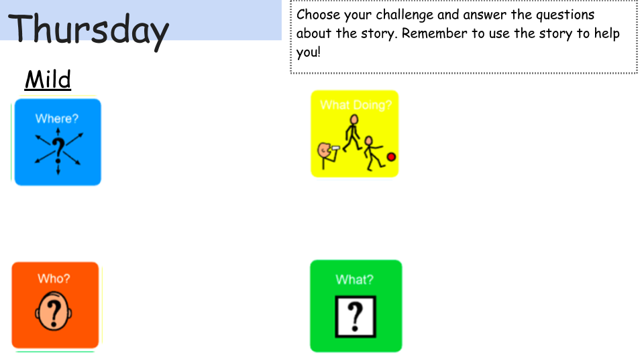
Where does George go? Type answer here
What does George do to the Dragon? Type answer here
Who does George fight? Type answer here
Where does George do at the end of the story? Type answer here

Slide 6
Medium/ Spicy: REMEMBER to answer in full sentences.
Why did George leave the Roman army? Type answer here
2. What word did the author use to describe the dragon? Think of three synonyms for that word. Type answer here
3. What was special about the healer? Type answer here

Slide 7
Medium/ Spicy: REMEMBER to answer in full sentences.
4. What does George say he will do to help? Type answer here
5. What happened to George when he tried to slay the dragon? What word does the author use to describe what is happening? Type answer here
6. What adjectives would you use to describe George's character?Why? Type answer here

Slide 8
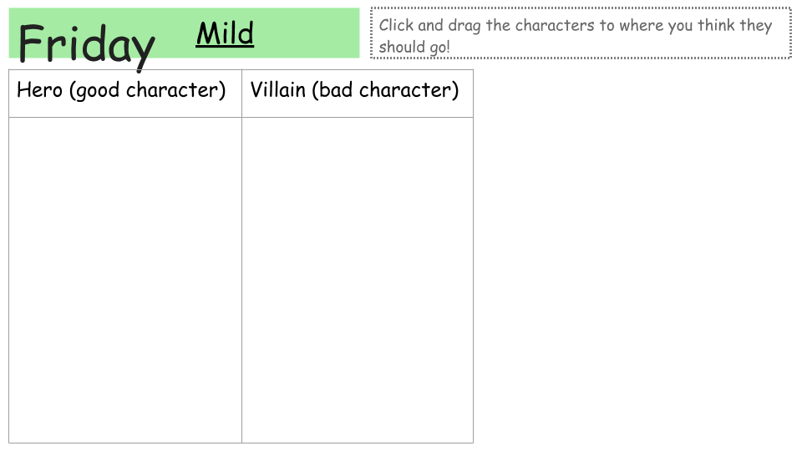
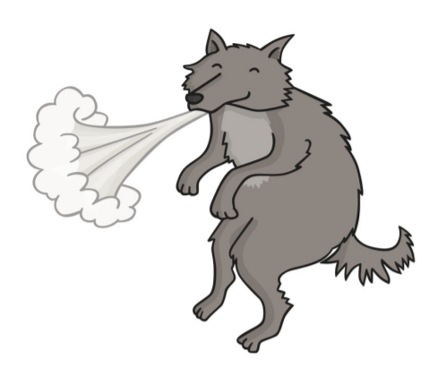
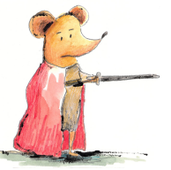

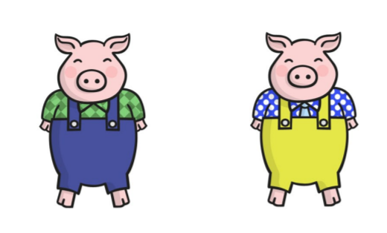
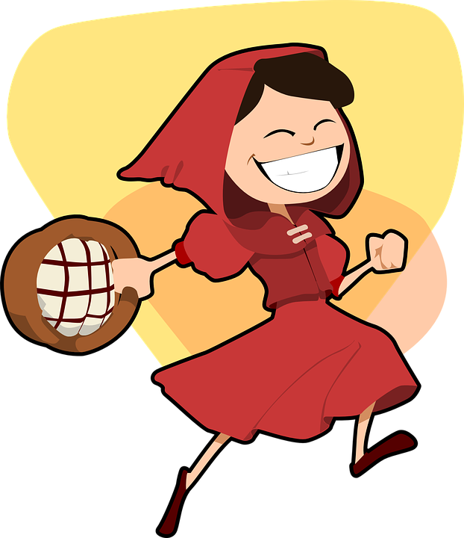
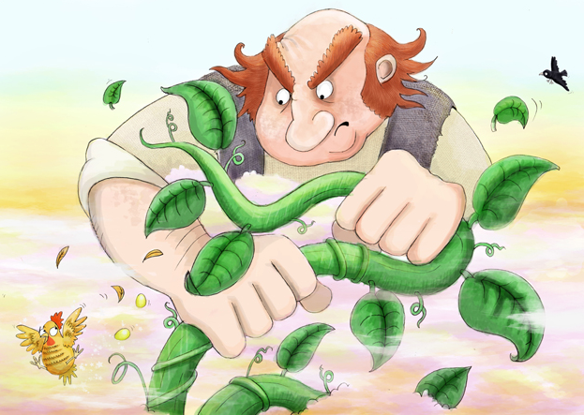

Slide 9
Medium/Spicy: Can you think about any other books that are similar to the story? Name the story and write their similarities and differences.
Type name of story here
Similarities | Differences
Type answers here | Type answers here

