Slide 2

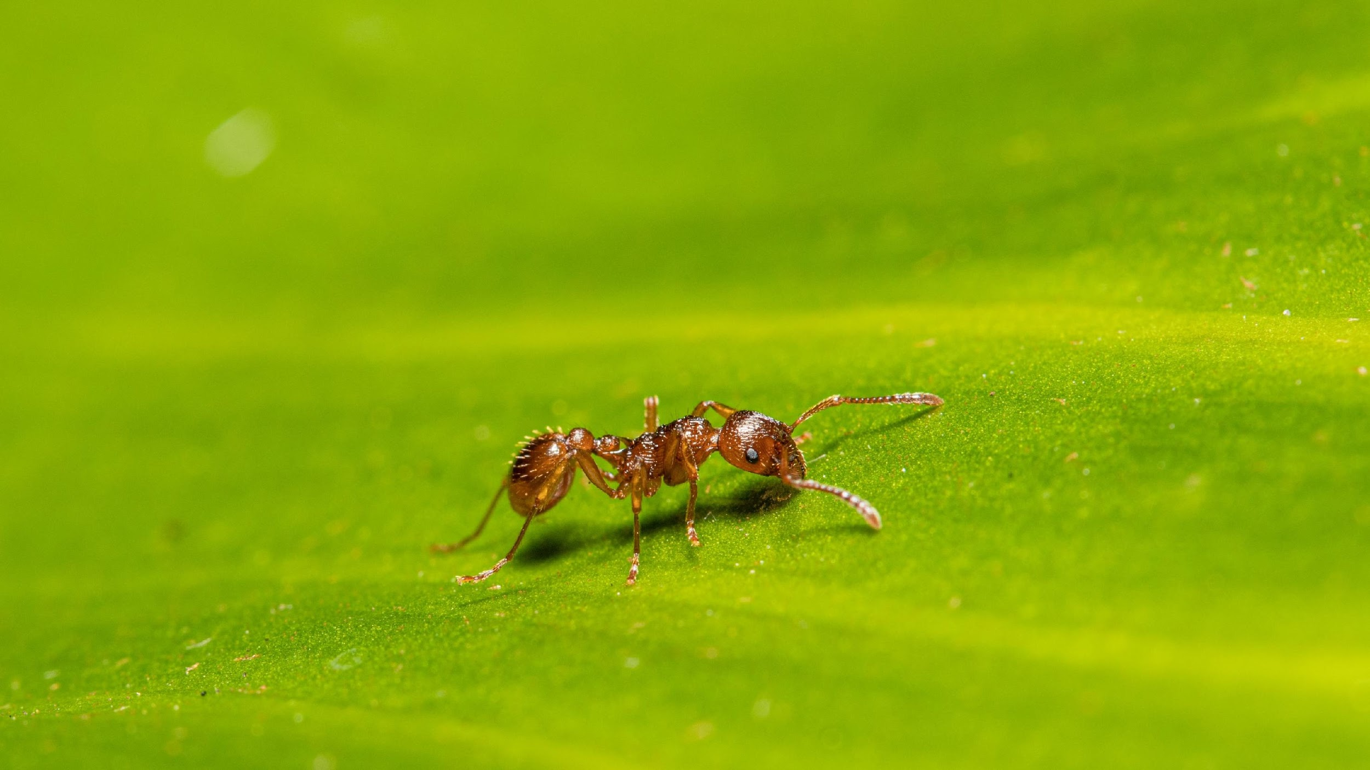

What am I looking at?

Slide 3
An Ant

Slide 4

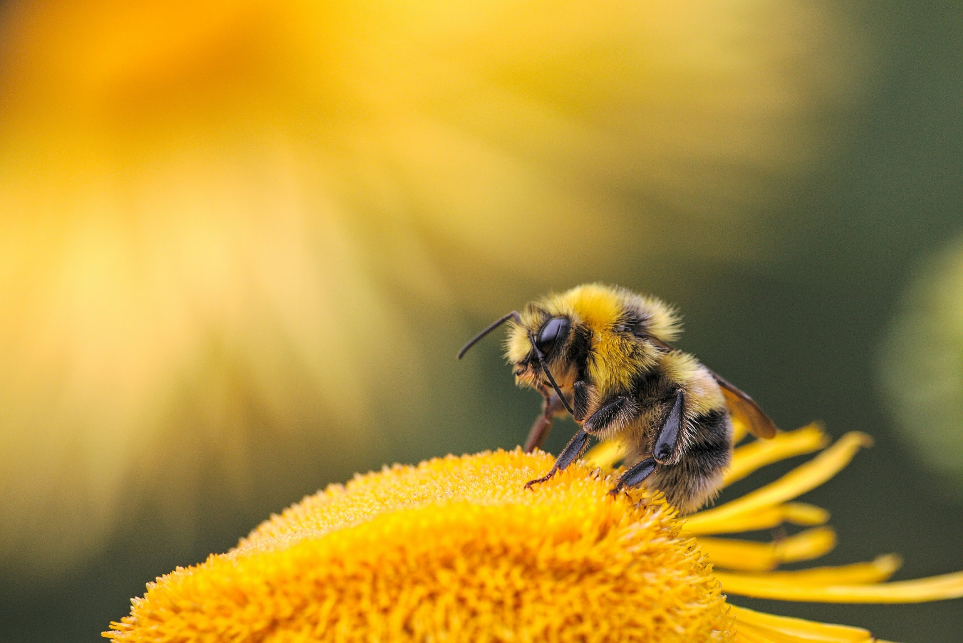
What am I looking at?

Slide 5
A bee!

Slide 6
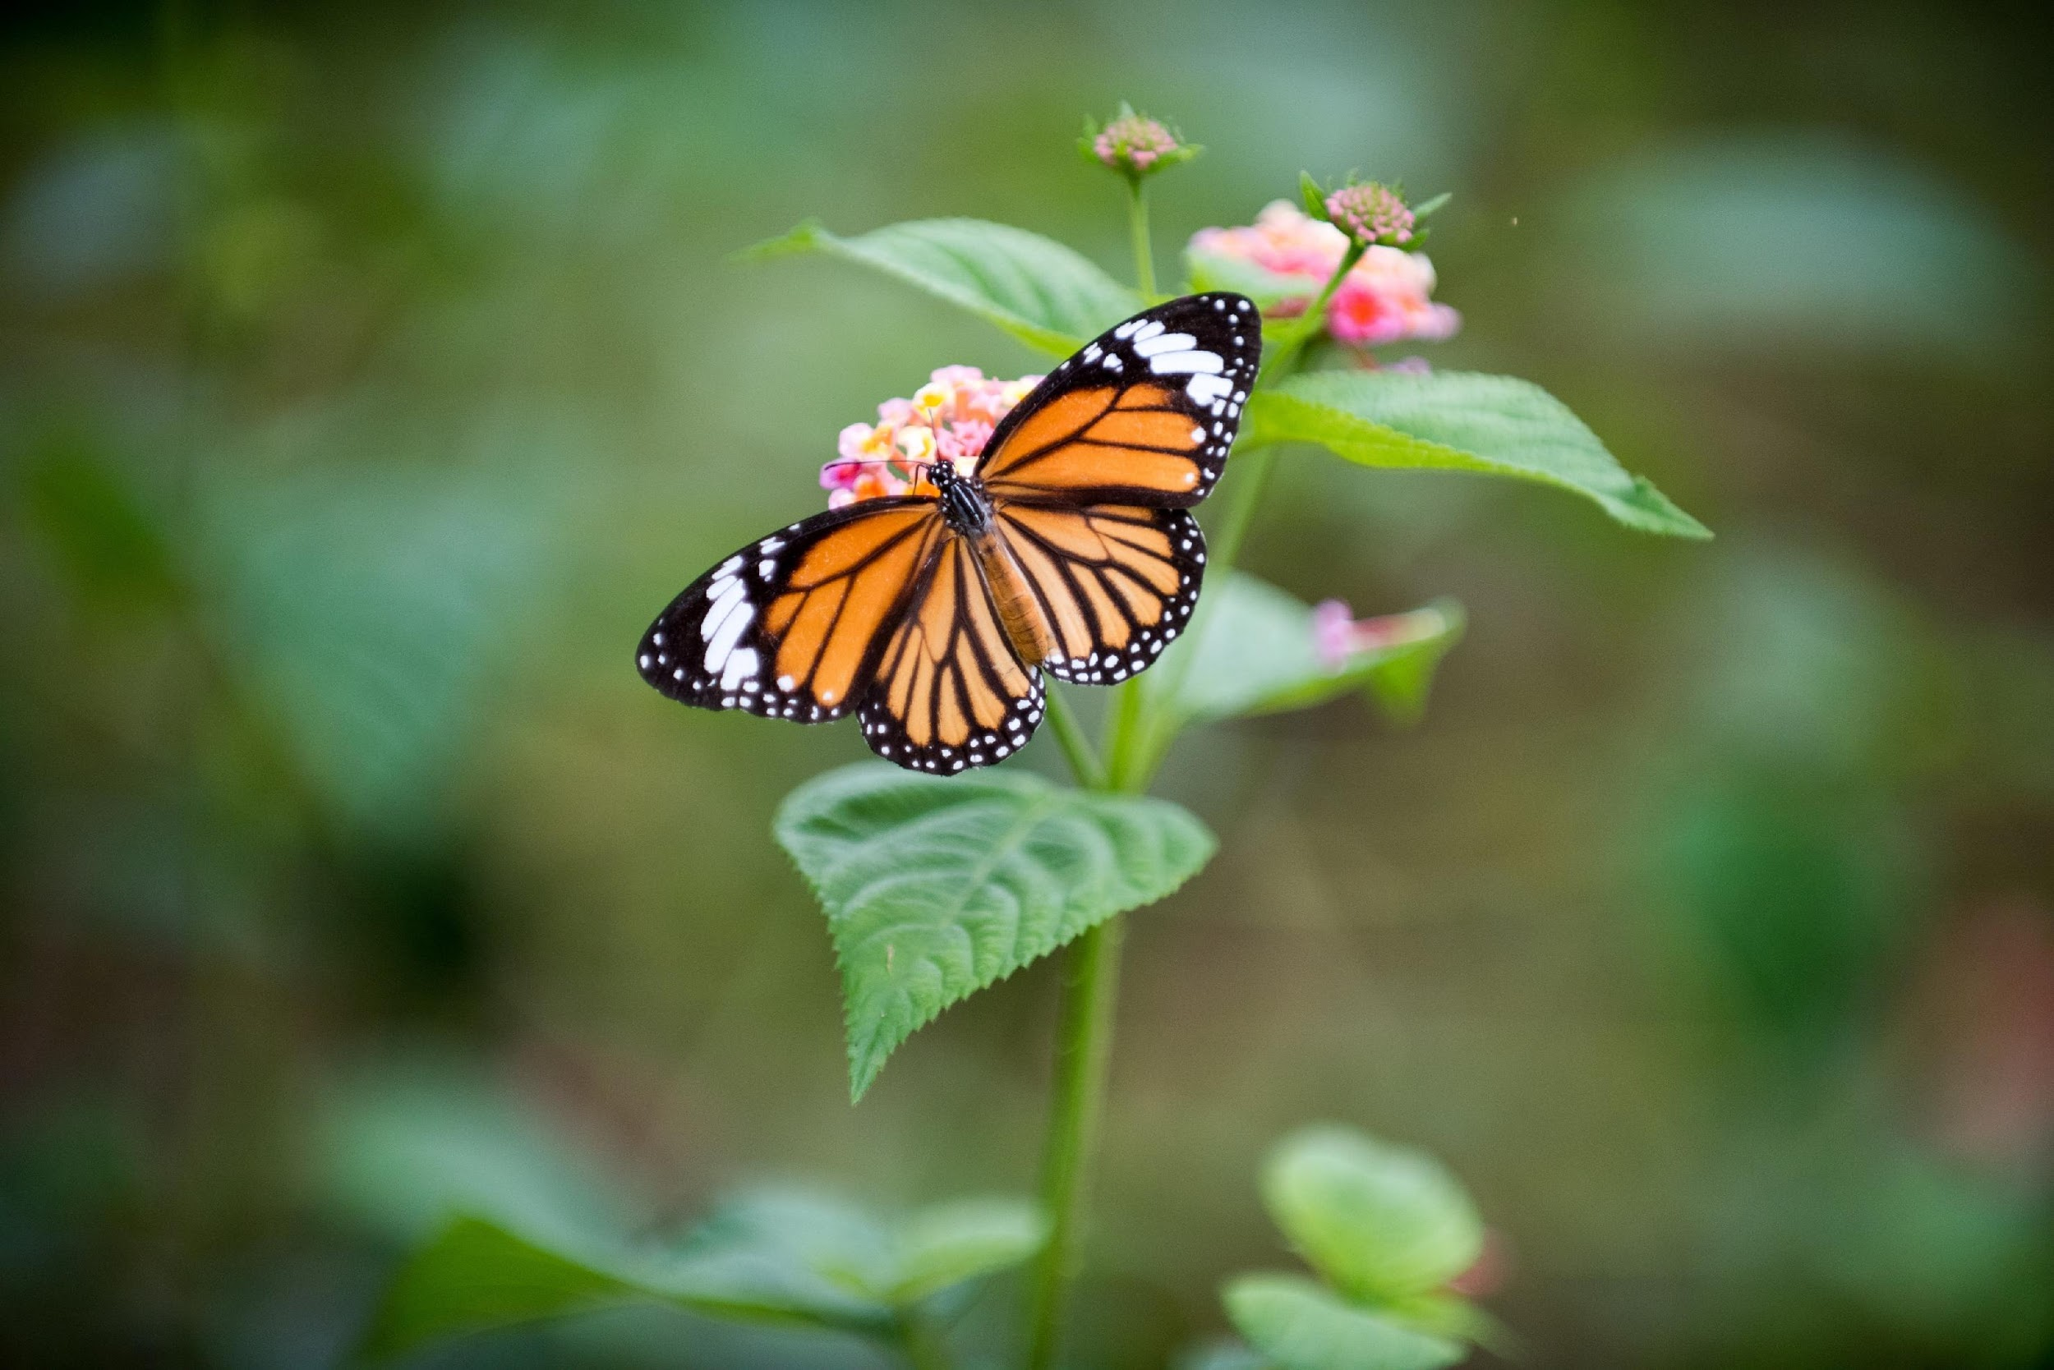
What am I looking at?

Slide 7
A Butterfly

Slide 8
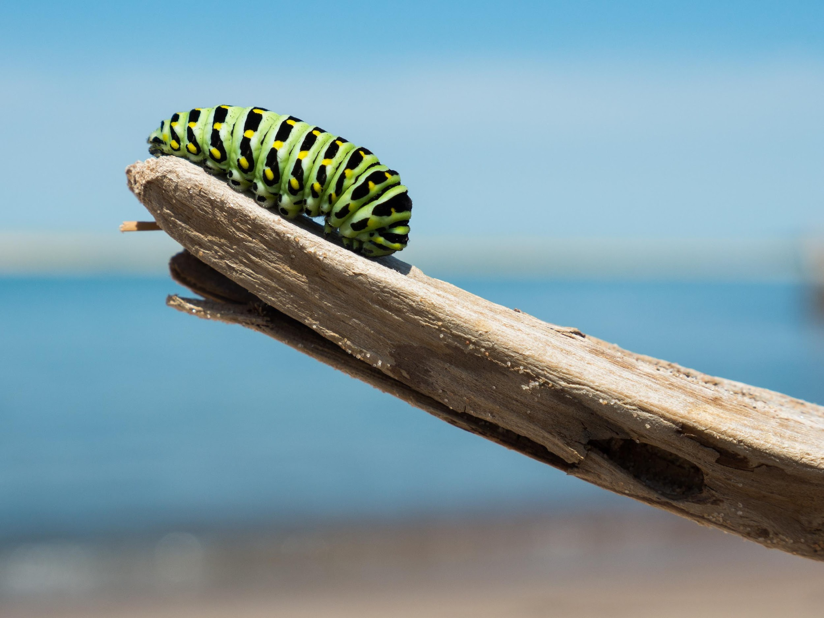
What am I looking at?

Slide 9
A caterpillar!

Slide 10
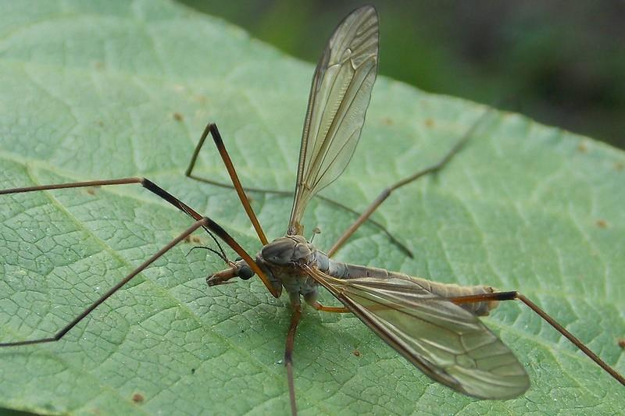
What am I looking at?

Slide 11
A crane fly!

Slide 12
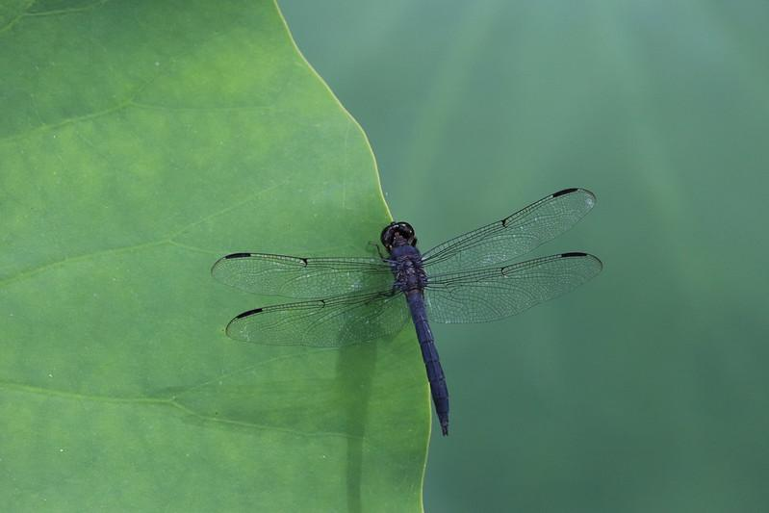
What am I looking at?

Slide 13
A dragon fly!

Slide 14
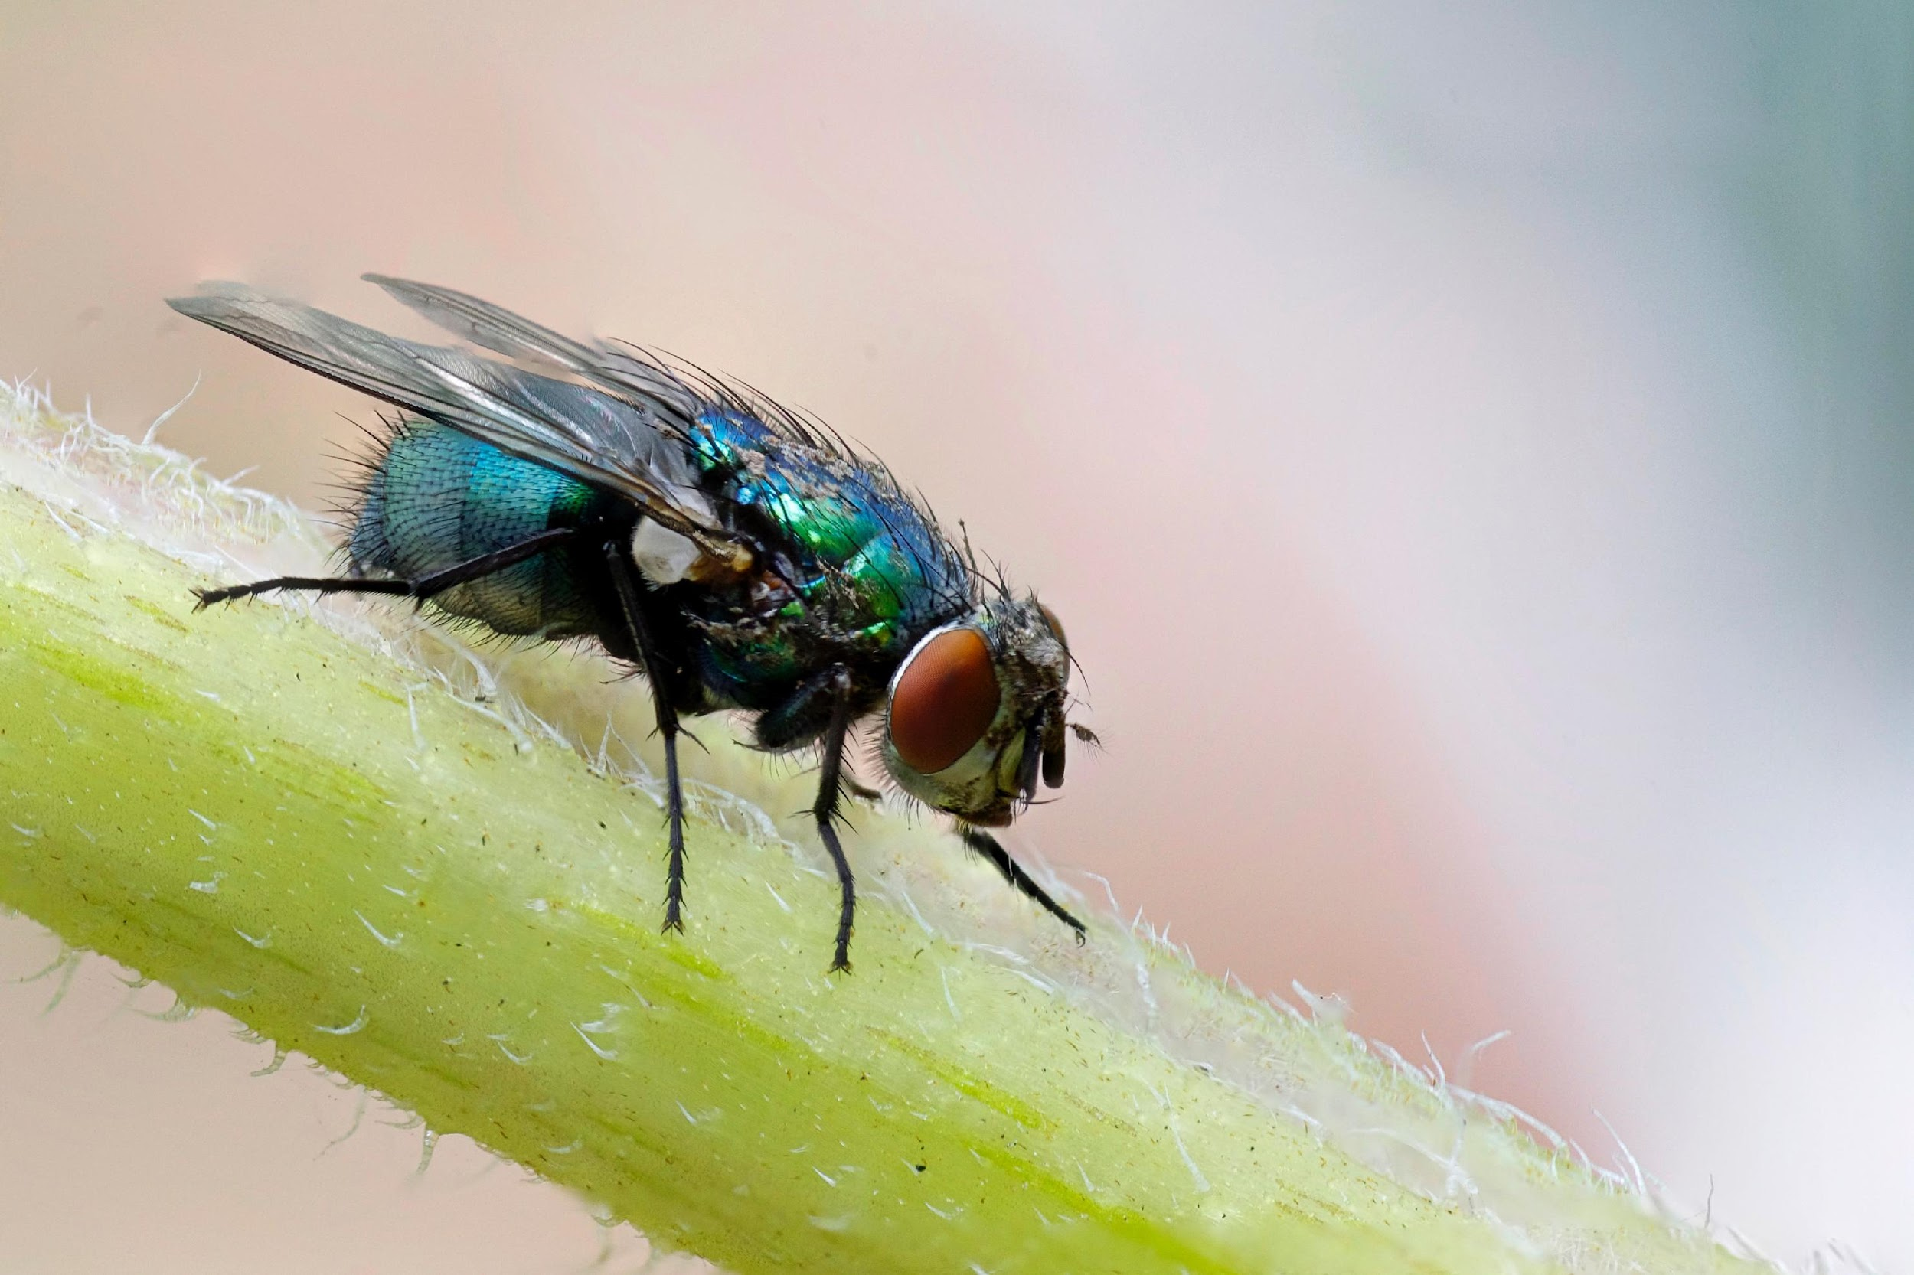
What am I looking at?

Slide 15
A fly!

Slide 16
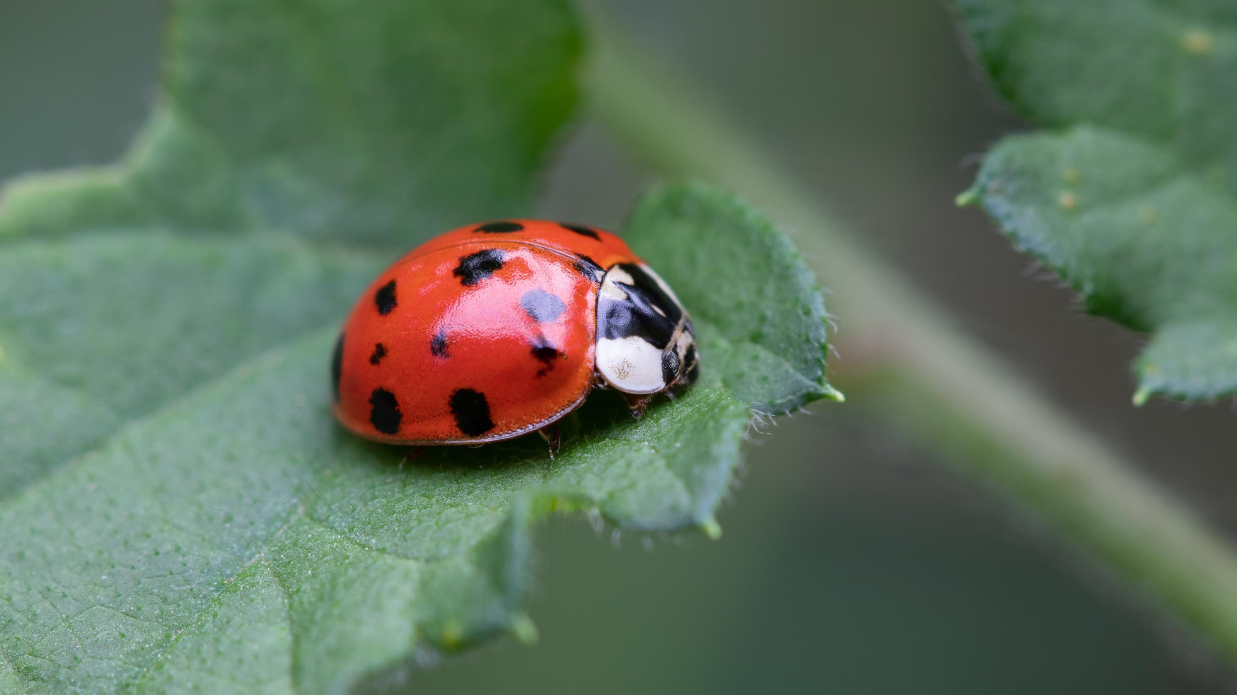
What am I looking at?

Slide 17
A ladybird!

Slide 18
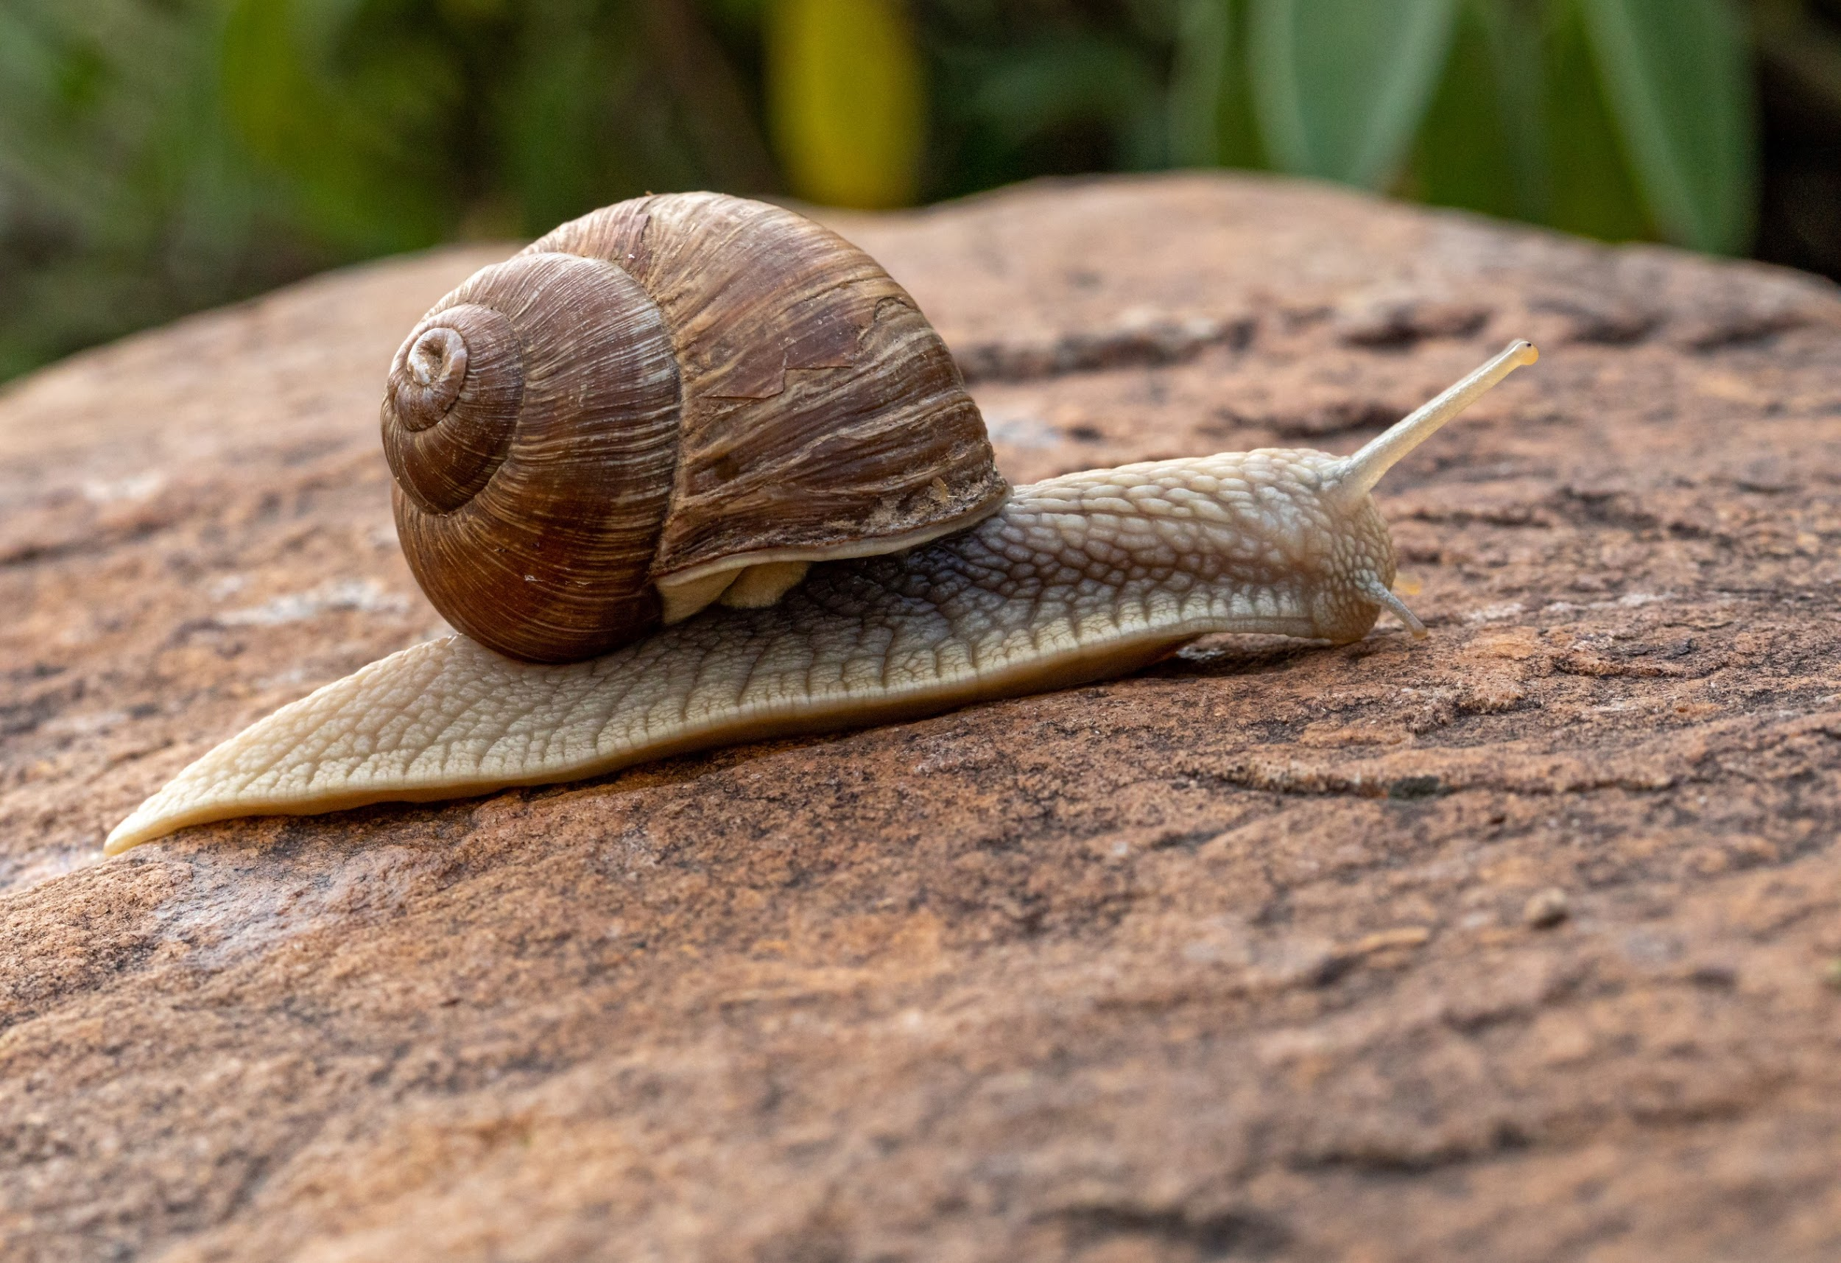
What am I looking at?

Slide 19
A snail!

Slide 20
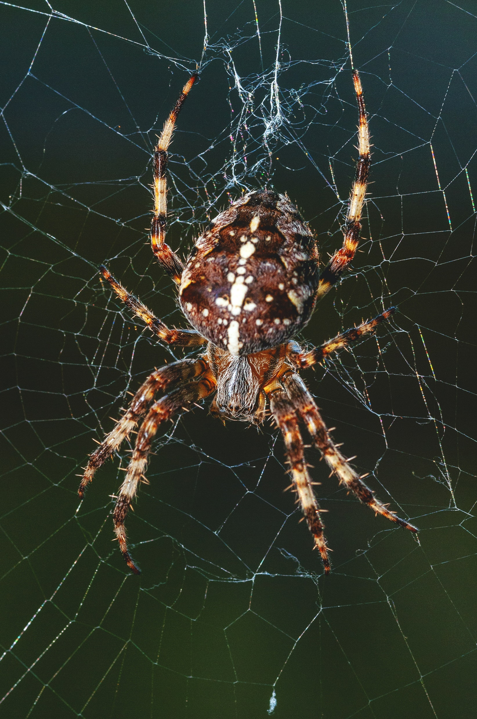
What am I looking at?

Slide 21
A spider!

Slide 22
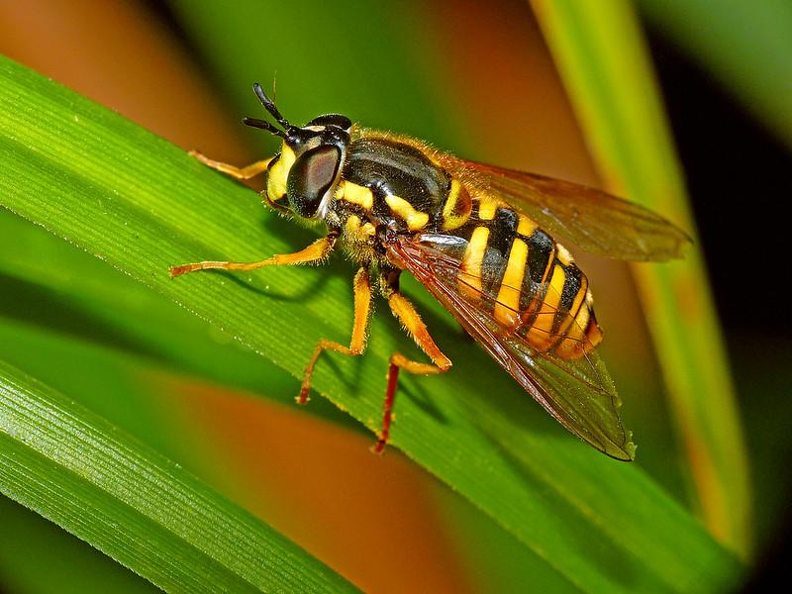
What am I looking at?

Slide 23
A wasp!

Slide 24
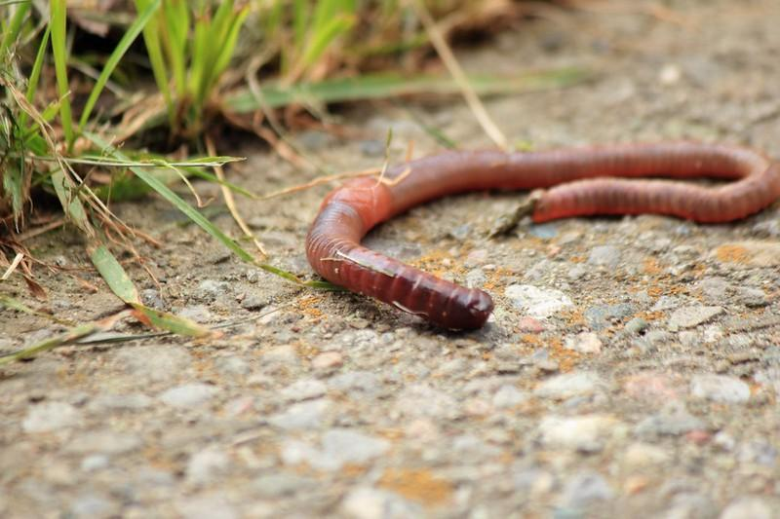
What am I looking at?

Slide 25
A worm!

